Slide 1
Module 1
Introduction to IPFusion

Slide 2
Introduction
Unified command and control
HMI: Human Machine Interface
Many independent systems on one desk
Connecting disparate systems and devices
Communicates between systems
Single user interface
Situational awareness and response
Executes SOPs (Standard Operating Procedures)

Slide 3
Why IPFusion?

Slide 4
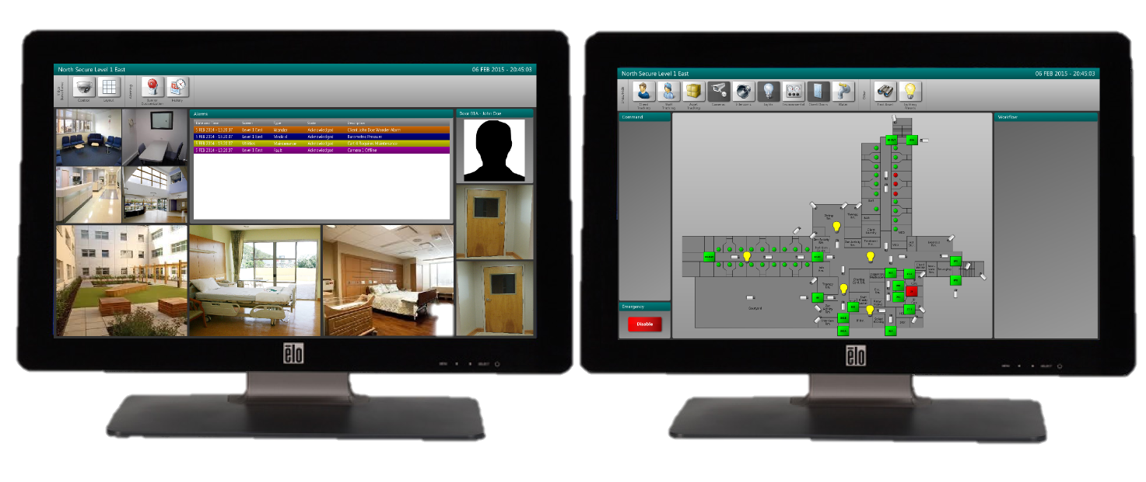
Why IPFusion? – One Integrated Solution
Interact with separate systems through a central hub
Provide users with a customizable user interface
Increases efficiency and situational awareness
Reduces administration time, simplifies monitoring
Reduces operator training time and cost
Enhances management reporting
Scalable and expandable

Slide 5
IPFusion Overview

Slide 6
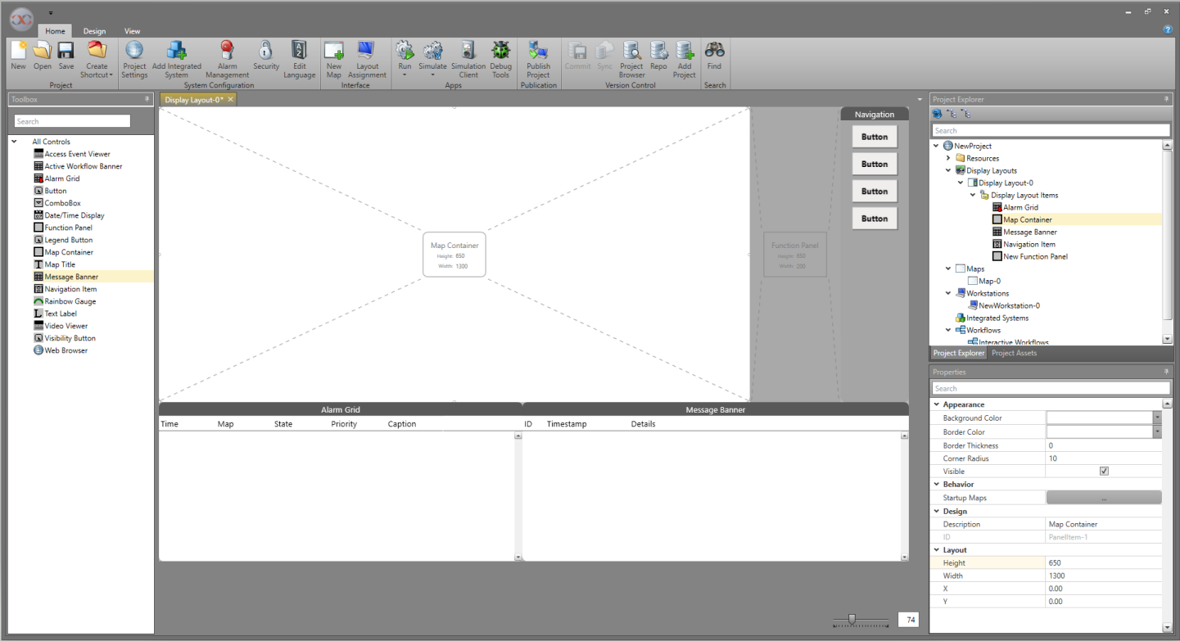
IPFusion Overview – Designer Application

Slide 7
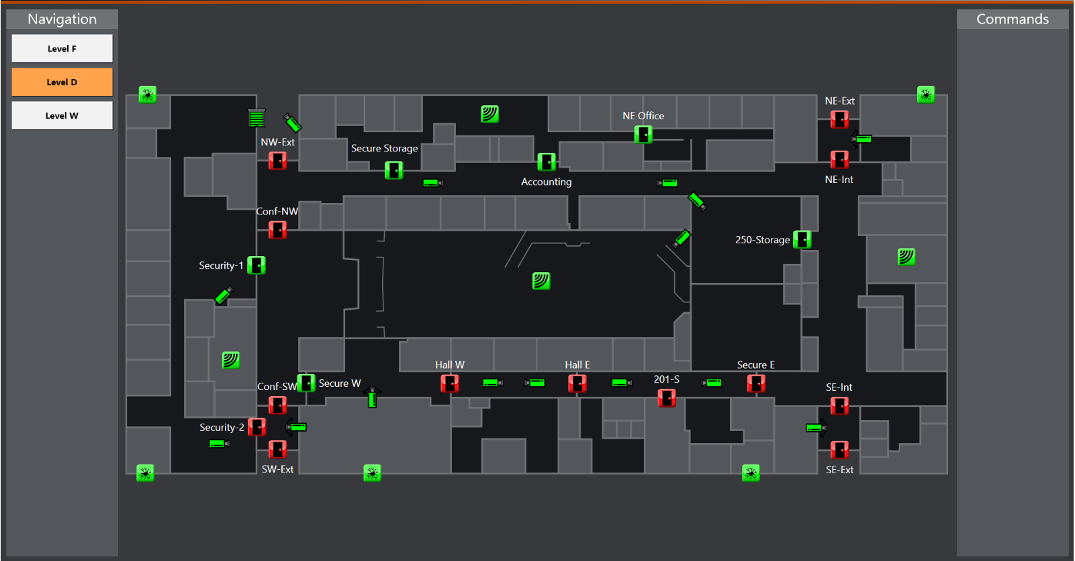
IPFusion Overview – Runtime Application
Can be run with a graphical interface or as a service
Runs projects created with Designer
Connects to third party systems

Slide 8
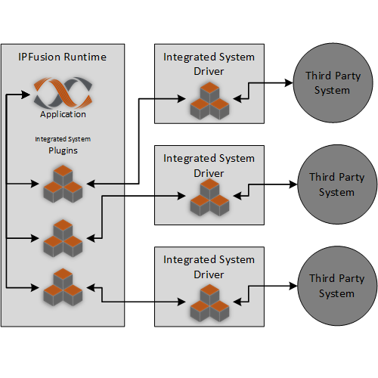
IPFusion Overview
Anything to anything
Plug-in architecture = modular approach

Slide 9
Website and Support
http://www.ipfusion.ca
Product Overview
http://partner.ipfusion.ca
Documentation, Downloads, Support
http://support.ipfusion.ca
Tickets, Forums, Knowledgebase

Slide 10
Solution Overview

Slide 11
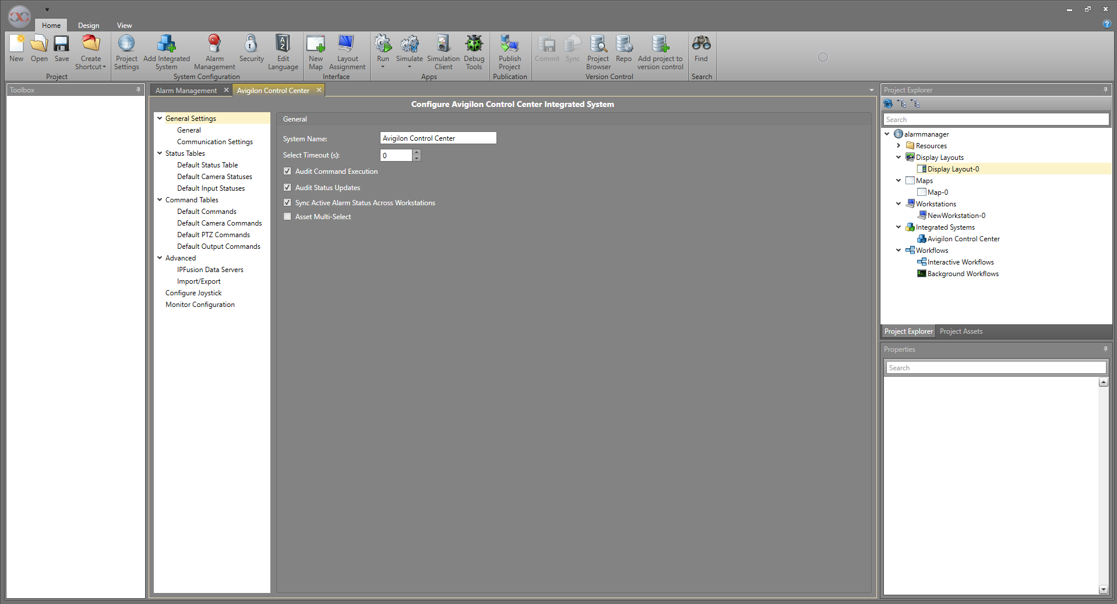
Solution Overview – Designer Application
Configures Integrated Systems

Slide 12
Solution Overview – Display Layout
Defines how Runtime operator’s screen appears
Displays controls and maps
Customizable

Slide 13
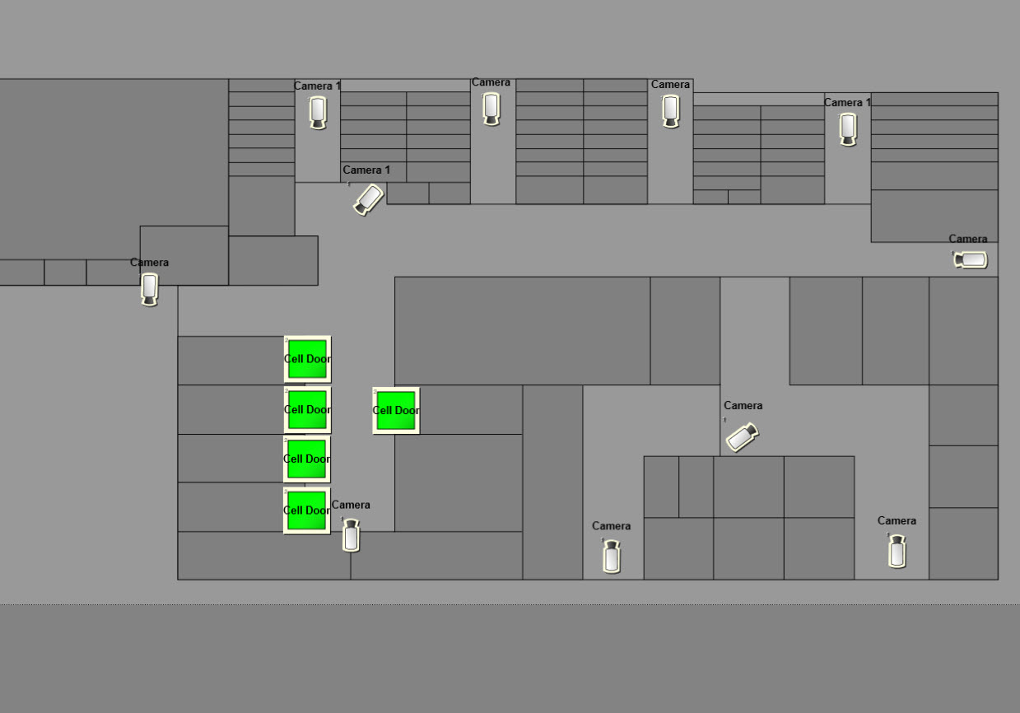
Solution Overview – Maps
Graphical Map can represent space in the real world or a logical collection of assets
Displays individual devices as icons

Slide 14
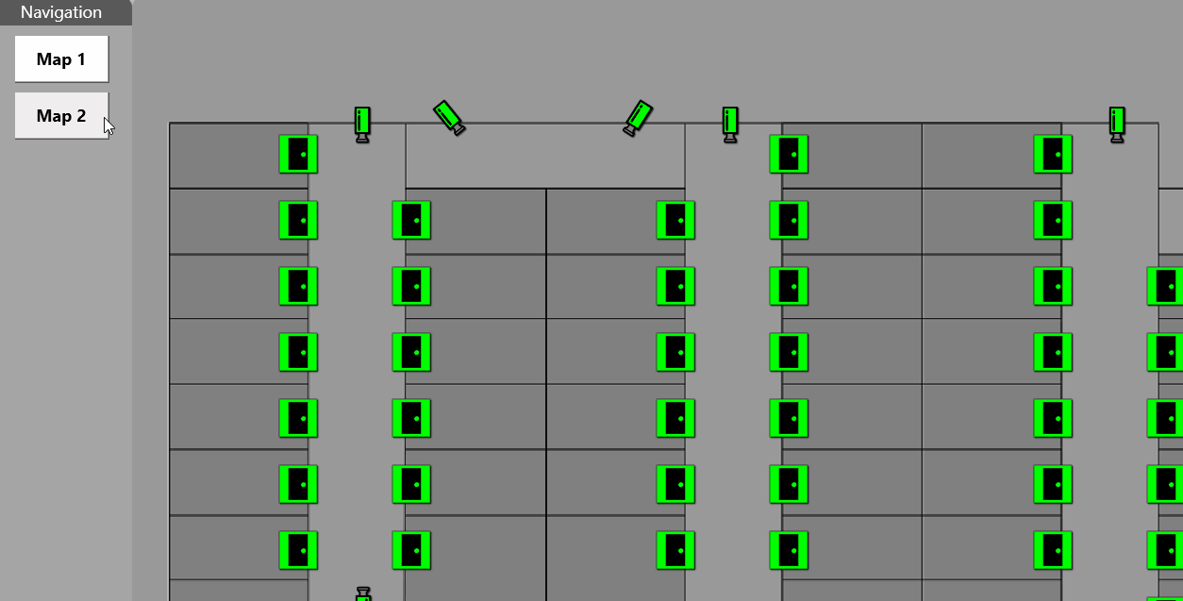
Solution Overview – Navigation
Allows access to multiple maps

Slide 15
Solution Overview – Integrated Systems
Multitude of systems and devices
Access control
Video Surveillance
Nurse Call
Intrusion detection
Lighting
SNMP
Perimeter intrusion
RTLS
OPC
Intercom

Slide 16
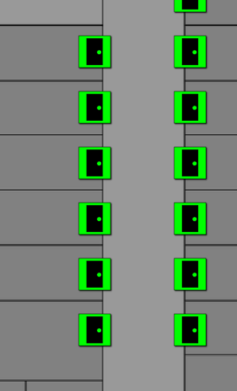
Solution Overview – Assets
Device, part of a third-party system
Camera, intercom station, network switch connection port, card reader, cell door, etc.
Represented on screen by an interactive icon
Displays status and have commands issued to them

Slide 17
Solution Overview – Alarming
Alarm posting by Workstation
Can log alarm types
Allows custom alarm annunciation
Sounds
Navigation button color
Alarm grid row colors
Priority

Slide 18
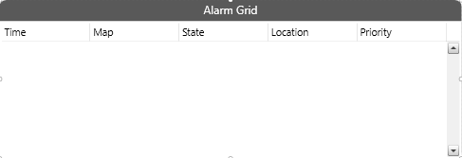
Solution Overview – Alarm Grid
Live display of active alarms
Central alarm response and management
Customizable columns

Slide 19
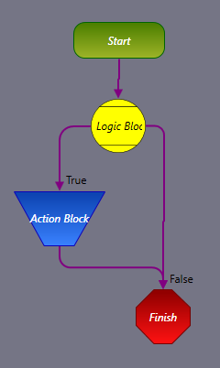
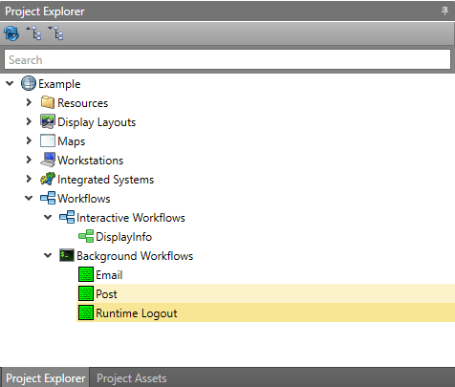
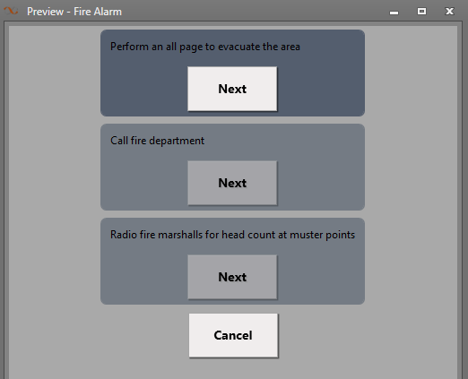
Solution Overview – Workflows
Interactive Workflows for response plans and standard operating procedures
Background Workflows for custom integration between integrated systems and procedures not requiring operator intervention
Interactive Workflow Presentation

Slide 20
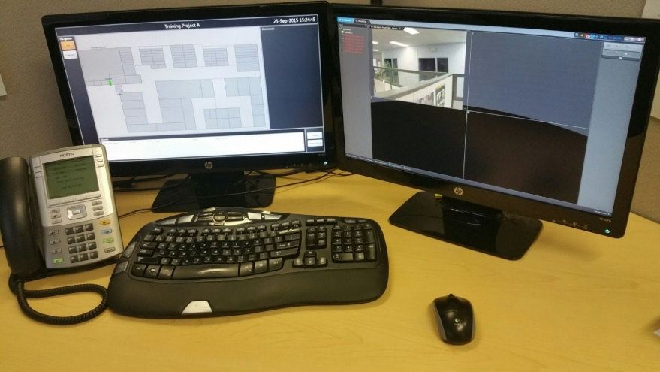
Solution Overview – Workstations
Represents physical control Workstation
IPFusion software
Where an IPFusion operator interacts with the system
Requirements
Windows 10
8GB memory
Intel Core i3-8100 or equivalent processor
1280x1024 screen resolution (1920x1080 recommended)

Slide 21
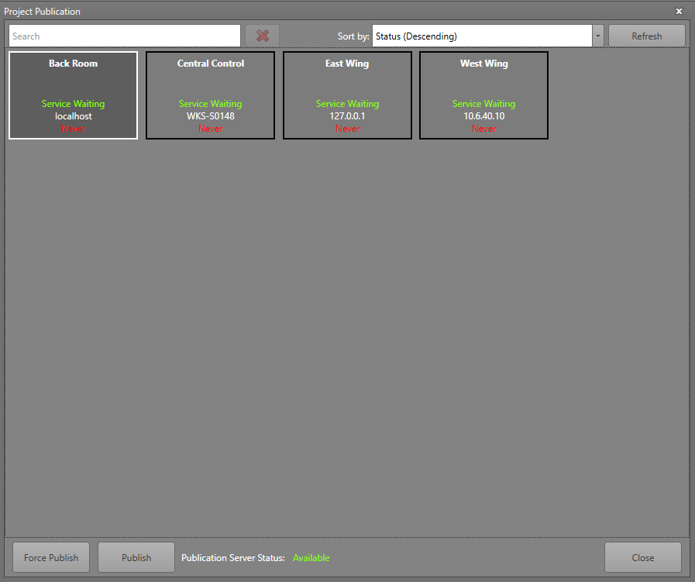
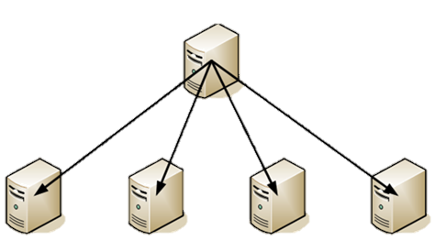
Solution Overview – Publication
Update Workstations with most recent software configuration
Unattended updates
Automatically reloads Runtime
One or more Workstations

Slide 22
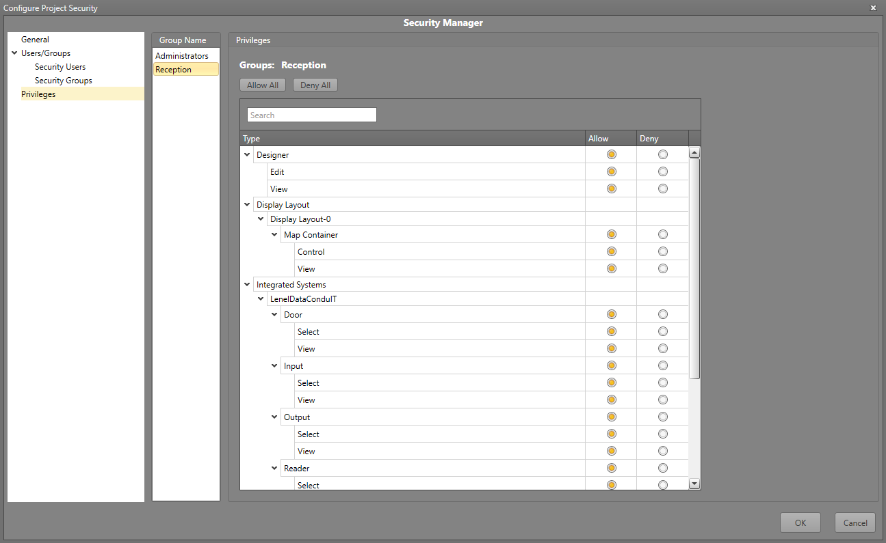
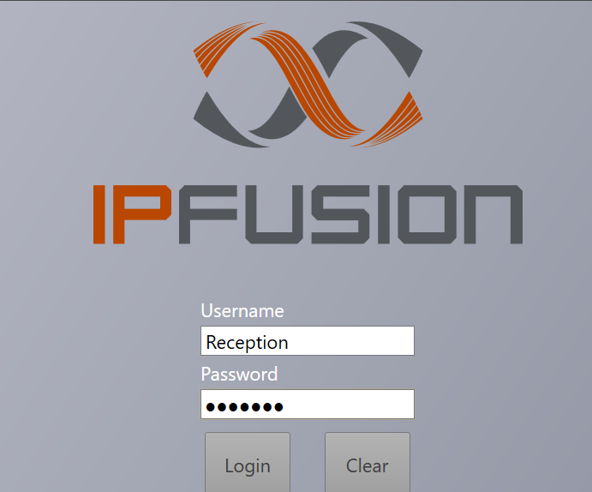
Solution Overview – User Security
Group-based security
Active Directory integration

Slide 23
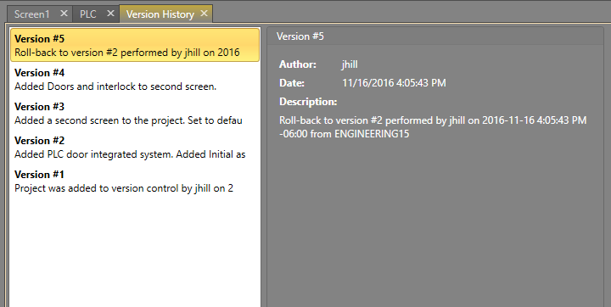
Solution Overview – Version Control
Track many projects
Commit and revert changes
Multiple Users

Slide 24
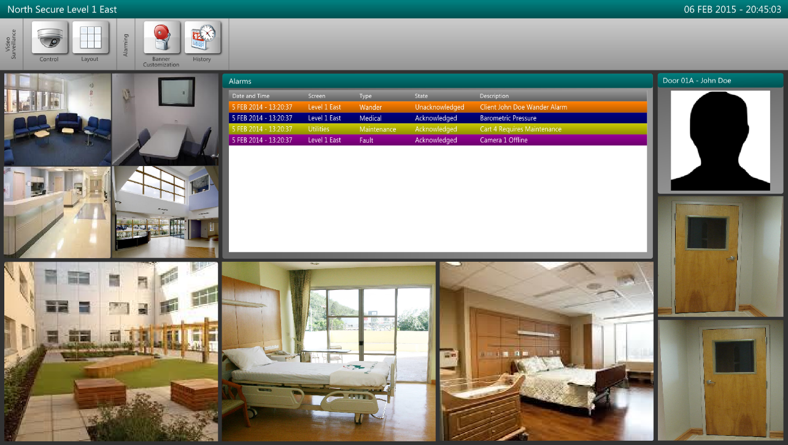
Solution Overview – Embedded Video
All sources into one viewer
Any size on template or full screen
Live and recorded video

Slide 25
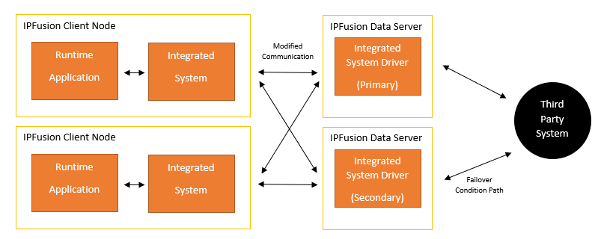
System Topology – Dedicated Redundant IPFusion Data Servers
Fully redundant
Enables scalability
High performance

Slide 26
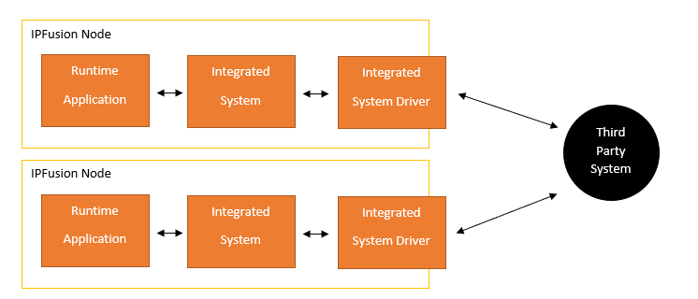
System Topology – Self-Sufficient IPFusion Workstations
Workstations host their own drivers
Workstations are self-sufficient

Slide 27
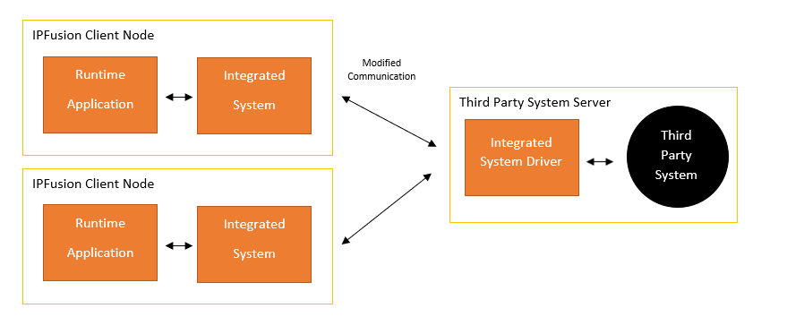
System Topology – Third Party System-Hosted Data Server
Third party system hosts the driver on same server

Slide 28
Additional Features

Slide 29
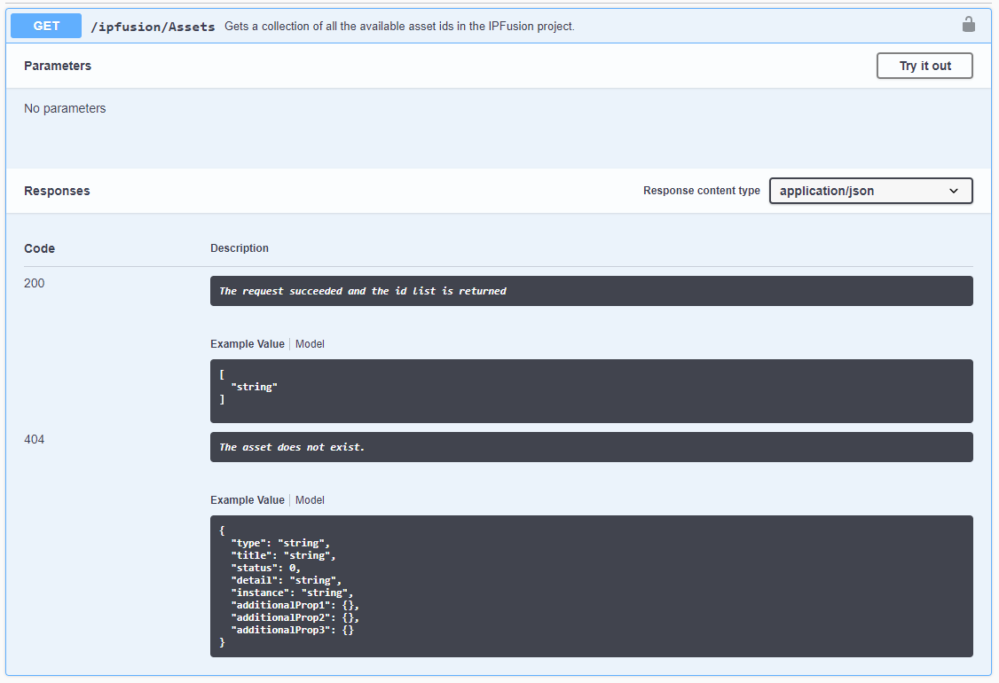
Additional Features – API
RESTful web-based API
Event stream
Execute commands and operations remotely
Get/set properties
Secure

Slide 30
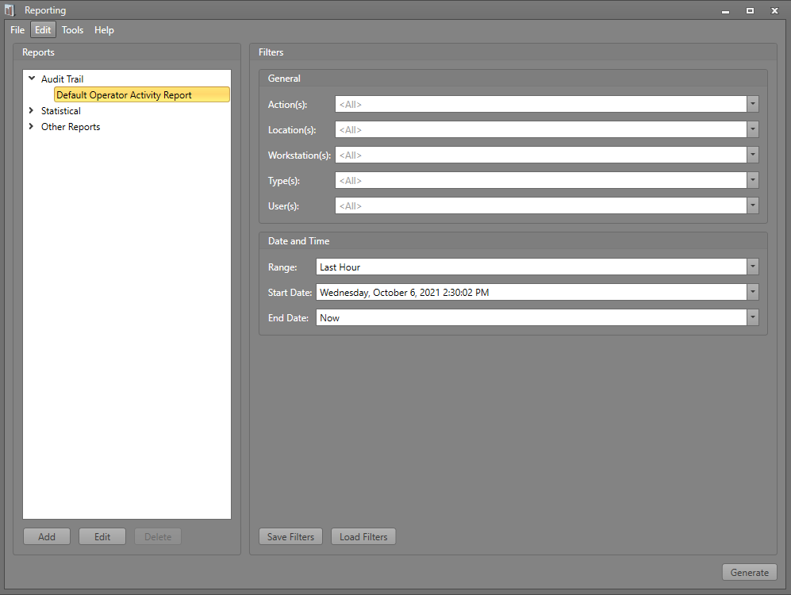
Additional Features – Logging and Reporting
Activity logging events and user actions
Statistics
Custom reports

Slide 31
Additional Features – Simulation App
Setup Scenarios
Trigger Alarms and Events
Training
Testing
Network connectivity

Slide 32
Additional Features – Debugging App
Connect to any IPFusion component
Auto Network Discovery
Message capture end to end
Live Output to Window, Text, SQL Database
Many data manipulation features

Slide 33
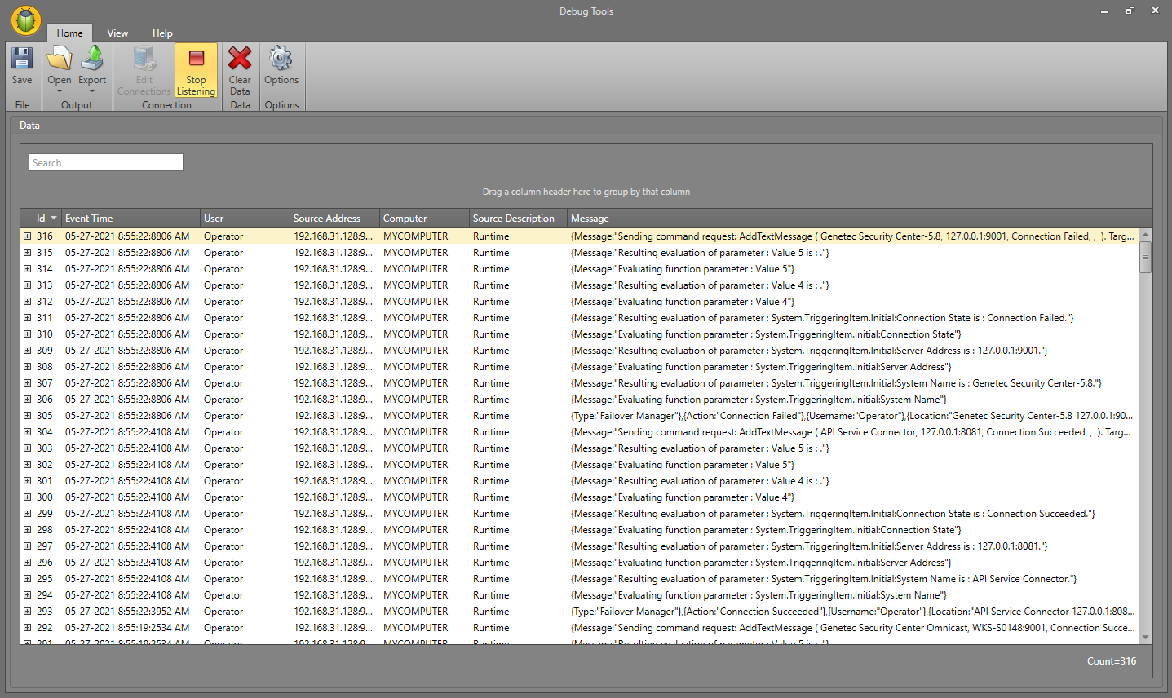
Additional Features – Debugging App

Slide 34
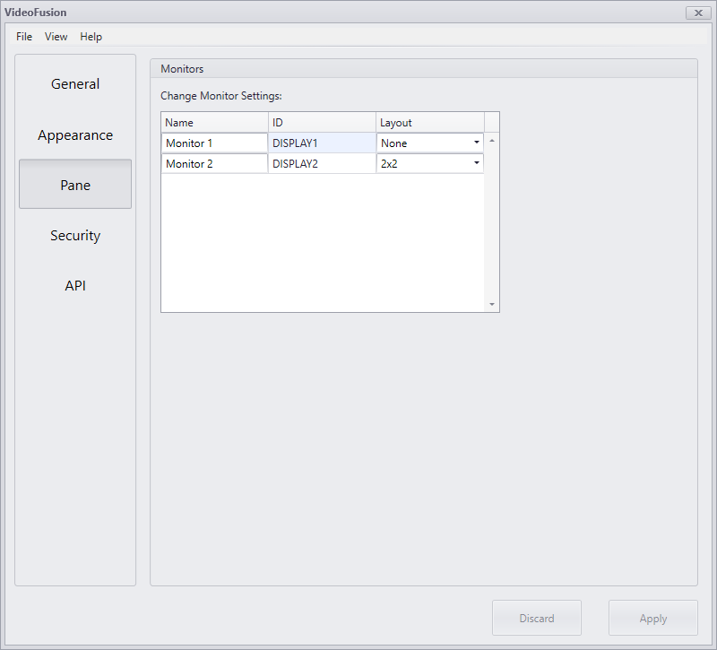
Additional Features – VideoFusion
Video wall display
Web service API
Many camera sources
ONVIF, Milestone, Genetec, etc.
Customizable look and feel

Slide 35
Module 1 Complete

