Slide 1
Module 11
Advanced Features:
Import/Export Integrated System Components

Slide 2
Overview

Slide 3
Overview
An integrated system is mainly composed of:
  Assets
  Status Tables containing the different asset states.
  Command Tables that have the different system commands.
  Camera Callups
A project can have multiple integrated systems working together, which results in an abundance of assets and status/command tables.
  This can make configuring the data longer and cumbersome.
The Import and Export function allows users to edit these different components via a .csv file in order to apply mass changes.

Slide 4
Generating Import Templates

Slide 5
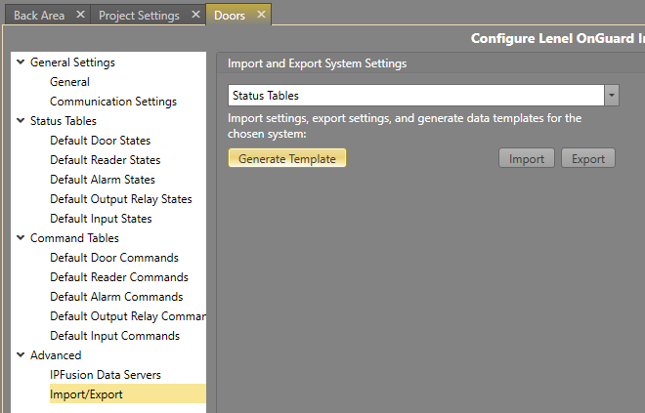
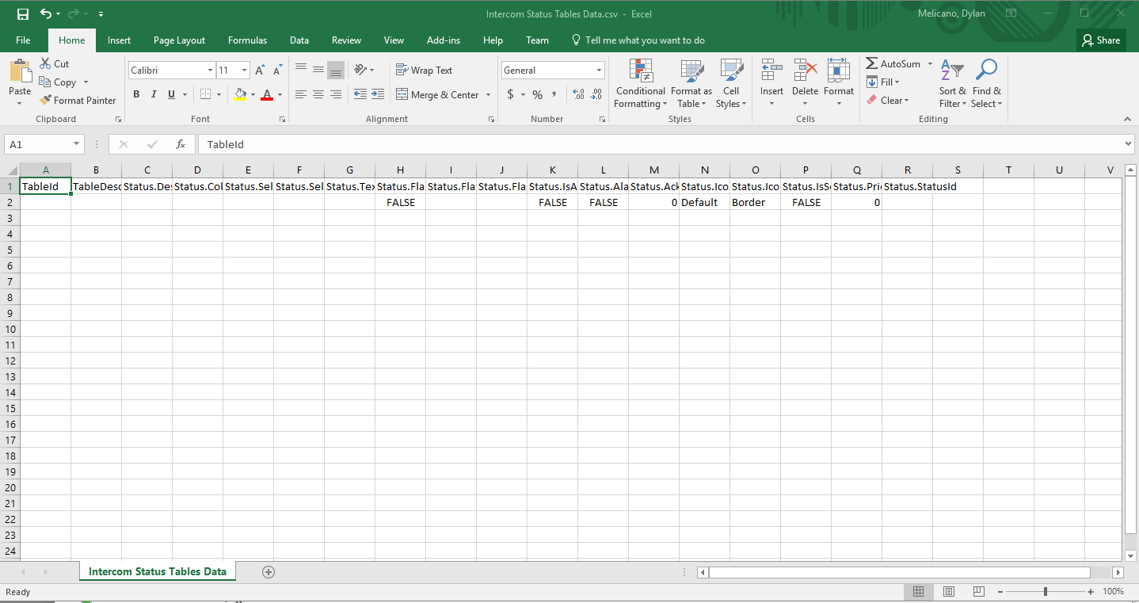
Generating Import Templates
Select the Generate Template button to create a data entry template for the component.
This creates a blank template where you can input all the data from scratch.

Slide 6
Import and Export Components

Slide 7
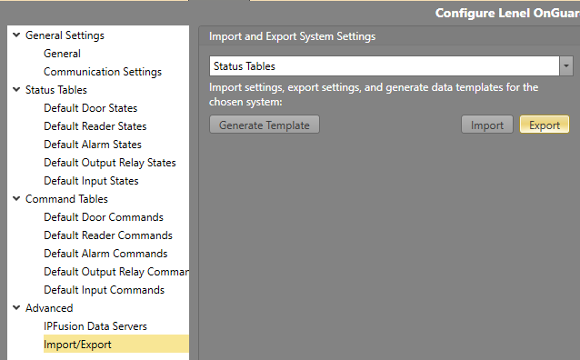
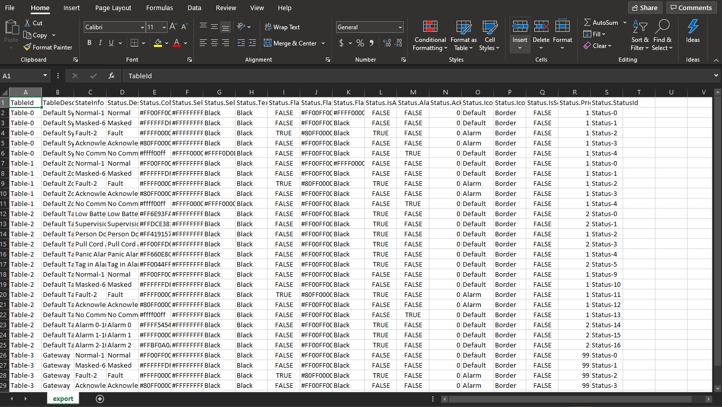
Export Components
Users can also export their current integrated system configurations into a .csv file.

Slide 8
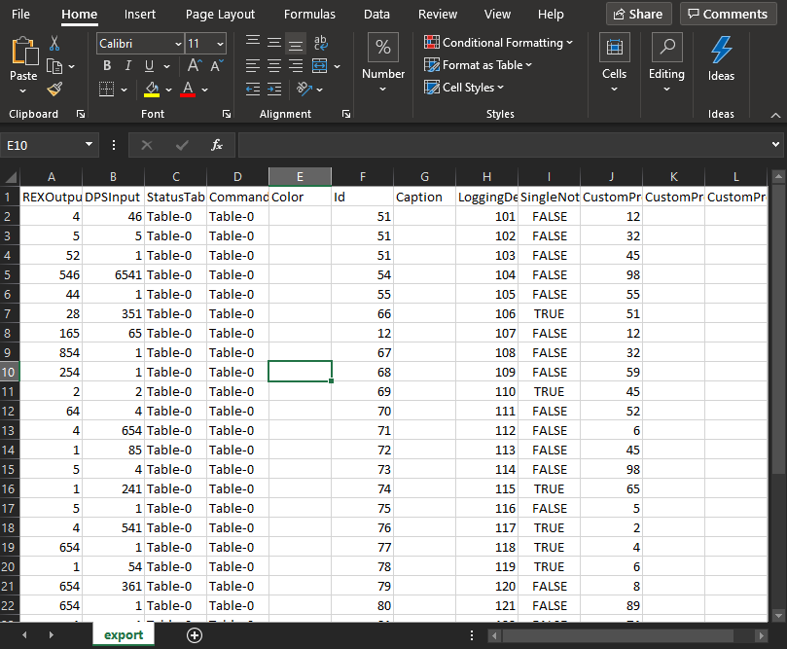
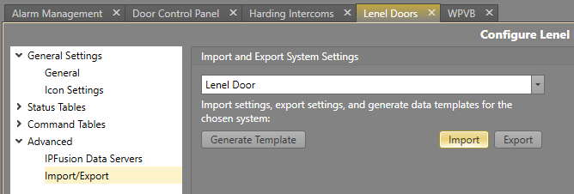
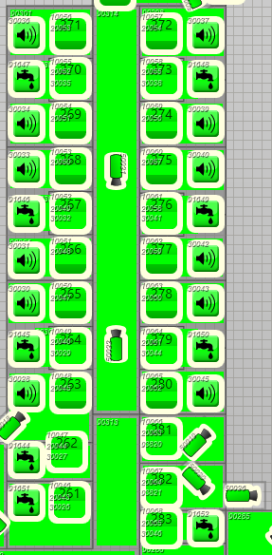
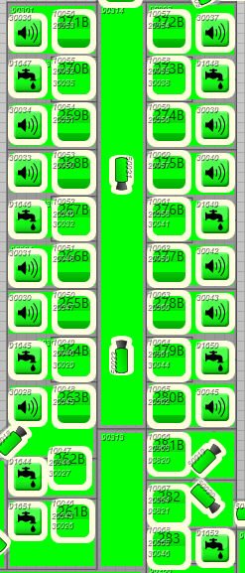
Import Components
After editing any of the data, users can import the .csv file so that the changes can be reflected in the project.

Slide 9
Module 11 Complete

