Slide 1
Module 13
Advanced Features:
IPFusion API

Slide 2
What is the IPFusion API?
The IPFusion API is a web-service for interacting with an IPFusion Runtime environment.
Allows the project items in Runtime to expose information for external access and interaction.
Is a separate Windows service, different from the Runtime executable.
Enable querying of states, setting of properties, and execution of commands remotely.
Allows for both HTTP (unsecured) and HTTPS (secured) connections

Slide 3
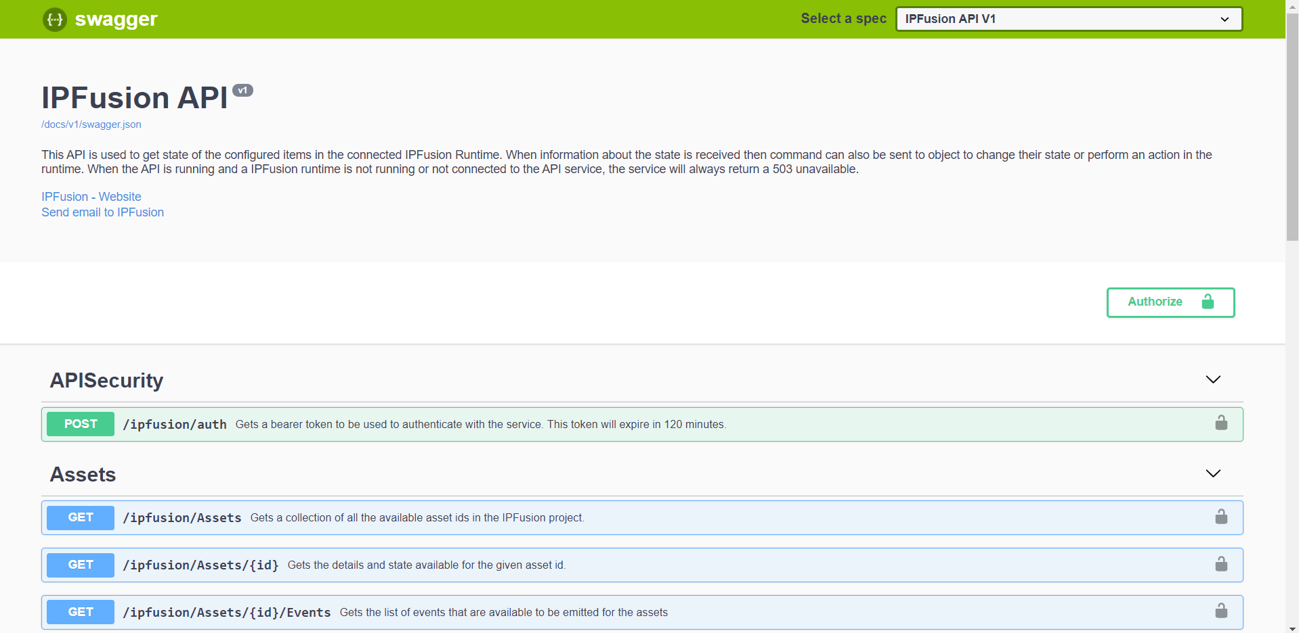
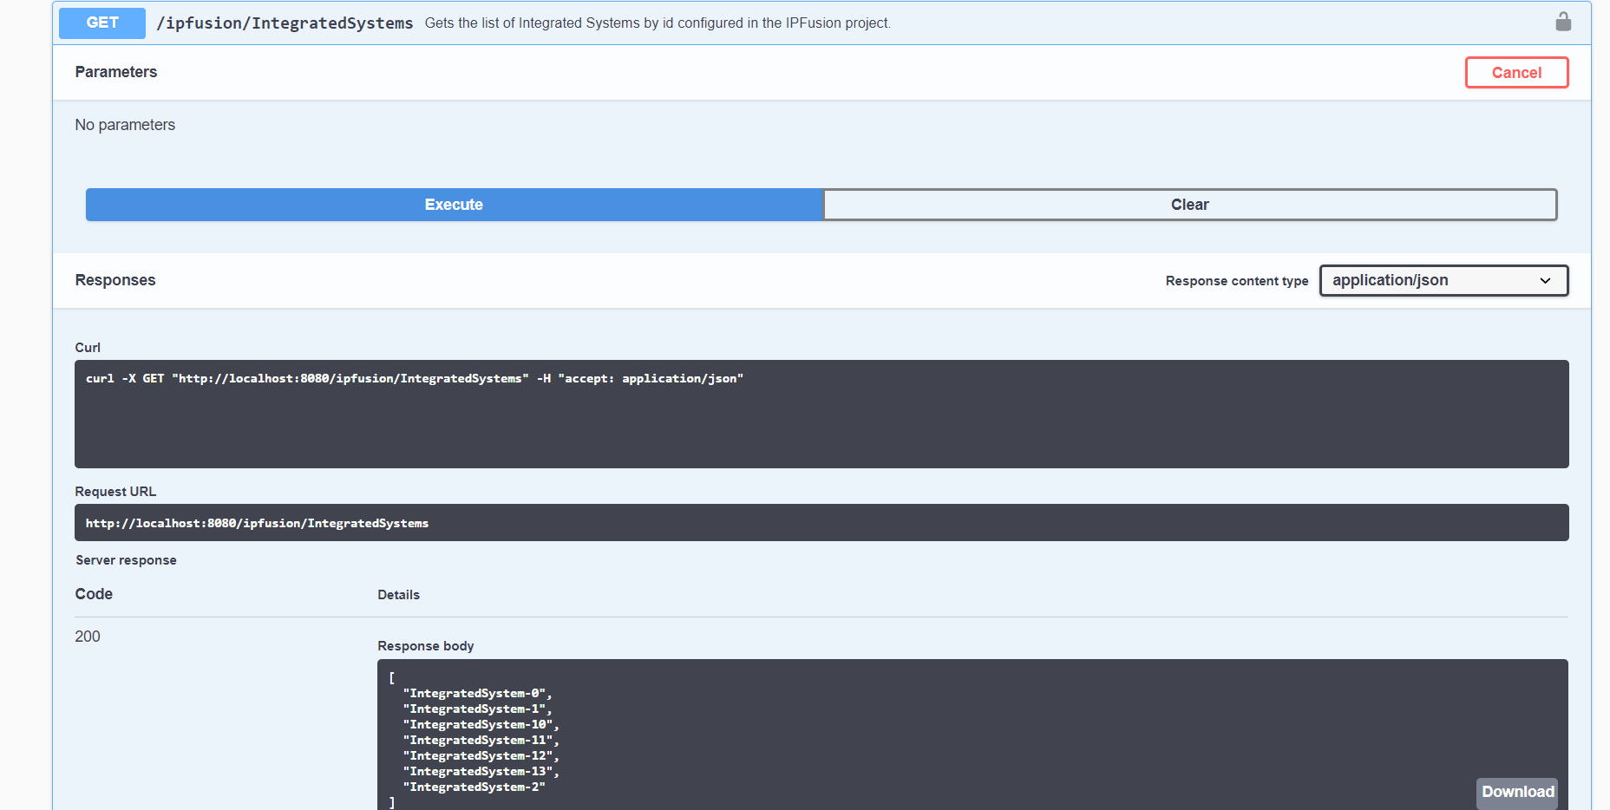
Self-documented

Slide 4
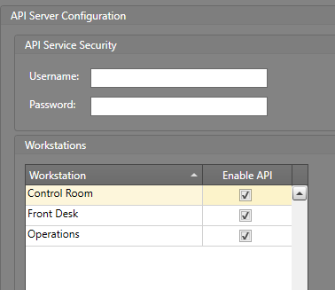
Installing and Enabling the API
Run the API installer on the Workstation you want the API to access.
In Designer, open the Project Settings and go to the API section.
Check Enable API Server on each Workstation you want it to run on.
  If you want to set login information, in Service Settings add a Username and Password.
  Note: Security must be enabled in the API service configuration file

Slide 5
Accessing the API
The API has three core operations: Get, Set, and Execute Command
  Depending on the Runtime entity, these can include additional parameters.
These can be accessed via HTTP GET or POST methods
Go here to view the available API commands:
  Unsecured: http://localhost:8080/docs
  Secured: https://localhost:8612/docs
Obtain or change a runtime entity’s data by inputting its type and ID in the GET links.
  http://localhost:8080/ipfusion/IntegratedSystems/IntegratedSystem-1/Assets
    This will retrieve the assets from the integrated system with an ID of IntegratedSystem-1

Slide 6
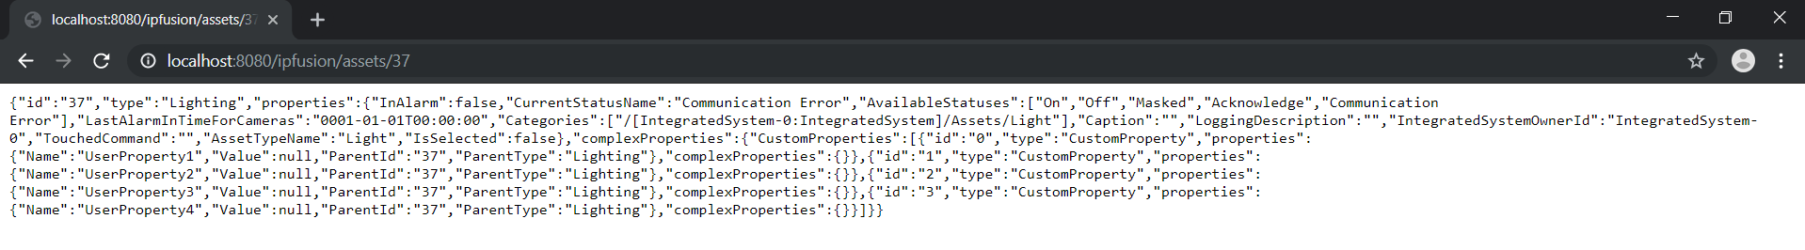
Example of an HTTP GET response for retrieving information about a specific asset.
All responses are provided in a standard JSON format.

Slide 7
Capabilities of the API
Change properties live during Runtime; changing their appearances, configured settings, etc.
Execute Asset commands remotely
Obtain current status and information.
Use an external application to interact with IPFusion.

Slide 8
Module 13 Complete

