Slide 1
Module 2
Designer Tools

Slide 2
Project Creation

Slide 3
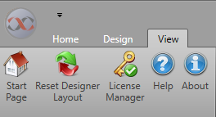
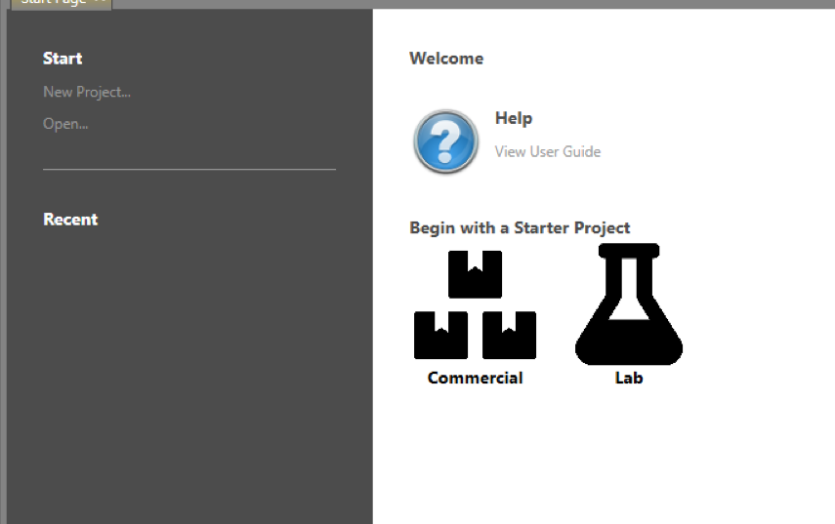
Start Page
Opens when starting Designer
Can be accessed from the View tab
Project management

Slide 4
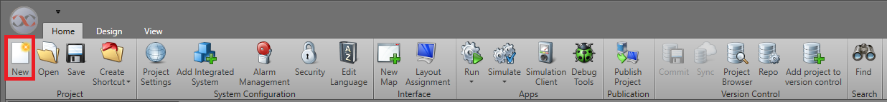
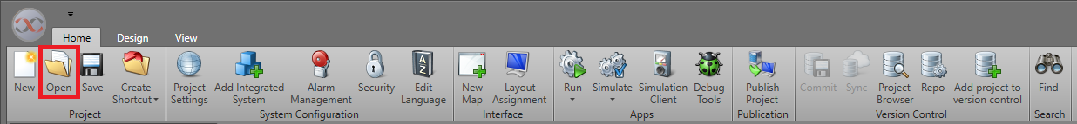
Home Tab — Project
New — Create new project
Open — Open existing project

Slide 5
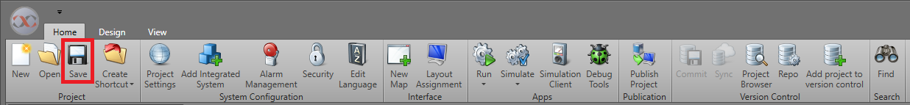
Home Tab — Project
Save
  Save current project

Slide 6
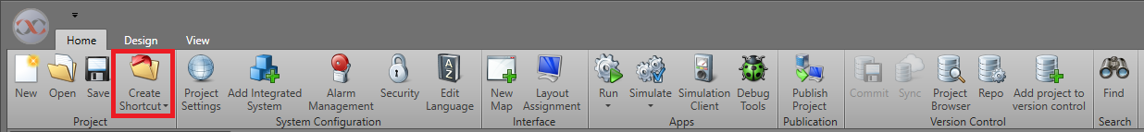
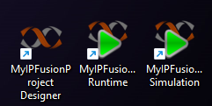
Home Tab – Project
Create Shortcut
  Designer: Launches Designer and automatically loads the current project
  Runtime: Launches Runtime and automatically loads the current project
  Simulation: Launches Runtime in simulation mode and automatically loads the current project

Slide 7

Design Tabs
Most tasks are performed in tabs

Slide 8
IPFusion Help

Slide 9
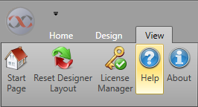
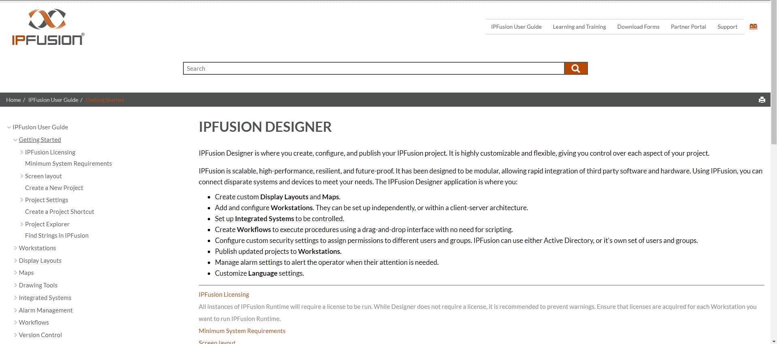
View Tab – Help
Open Designer user guide
F1 Context-sensitive help

Slide 10
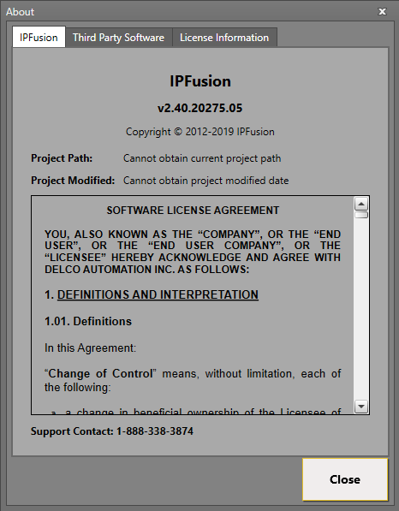
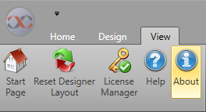
View Tab – About
Open IPFusion Designer License Information window

Slide 11
Project Explorer

Slide 12
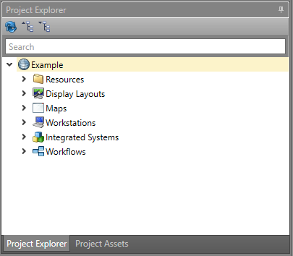
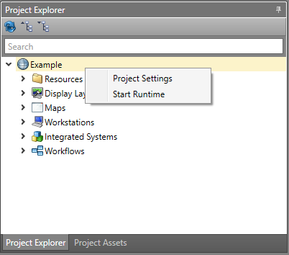
Project Explorer – Project
Top level of Project Explorer, contains all other elements
Right click access to settings and Runtime
Right-click menu

Slide 13
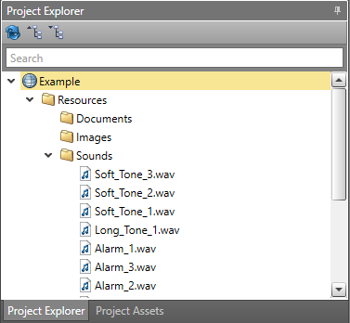
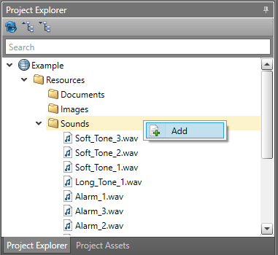
Project Explorer – Resources
Add and store files for use throughout the project
Right-click menu

Slide 14
Project Explorer – Resources
Documents
  Some integrated systems require configuration files uploaded here
Images
  Used in many places such as map backgrounds and icon images
Sound Files
  Used for alarms

Slide 15
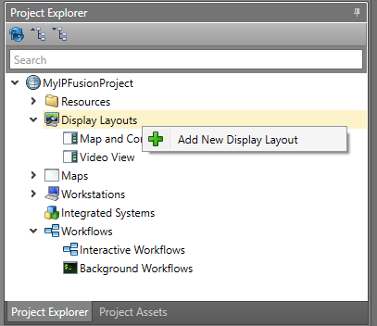
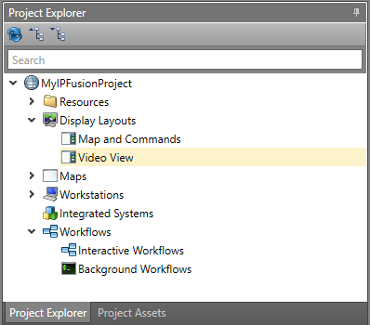
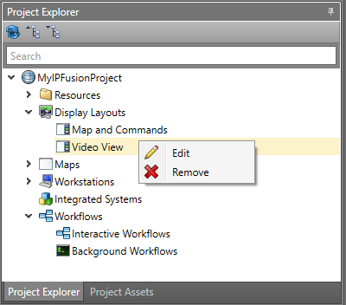
Project Explorer – Display Layouts
Add and Display Layouts

Slide 16
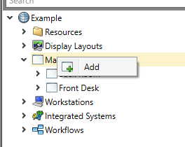
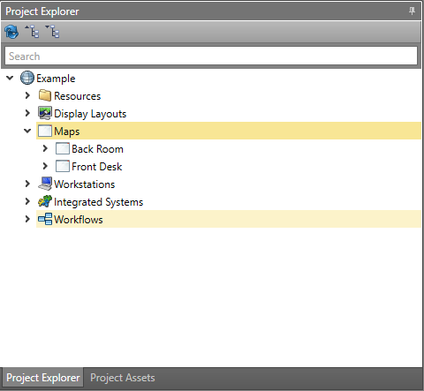
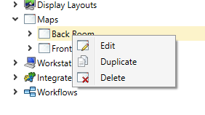
Project Explorer – Maps
Add and manage Maps

Slide 17
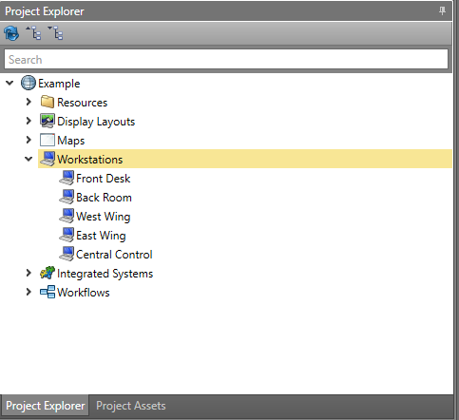
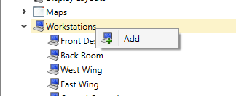
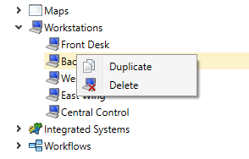
Project Explorer – Workstations
Add and manage Workstations

Slide 18

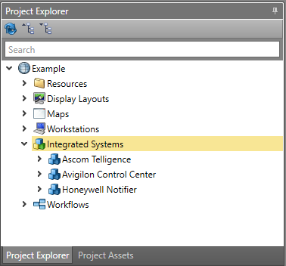
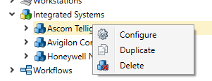
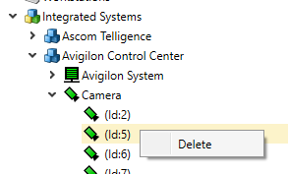
Project Explorer – Integrated Systems
Add and manage Integrated Systems
Right click access to system configuration

Slide 19
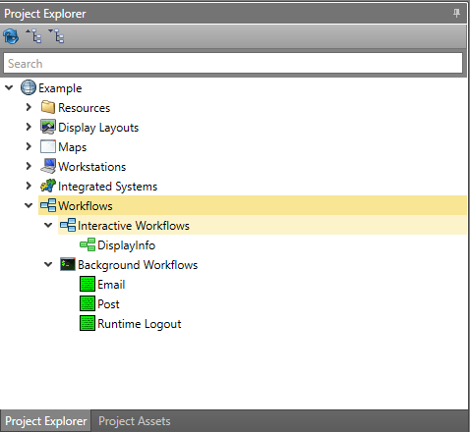

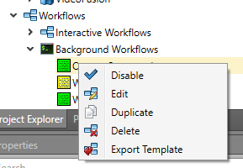
Project Explorer - Workflows
Add and configure Workflows

Slide 20
Adding and Configuring Systems

Slide 21
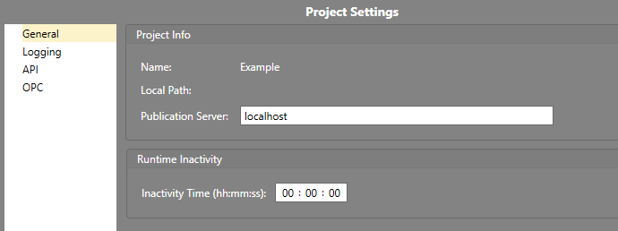
Project Settings
General
  See the project’s local path
  Set Publication Server
  Set time before a user in Runtime is considered inactive

Slide 22
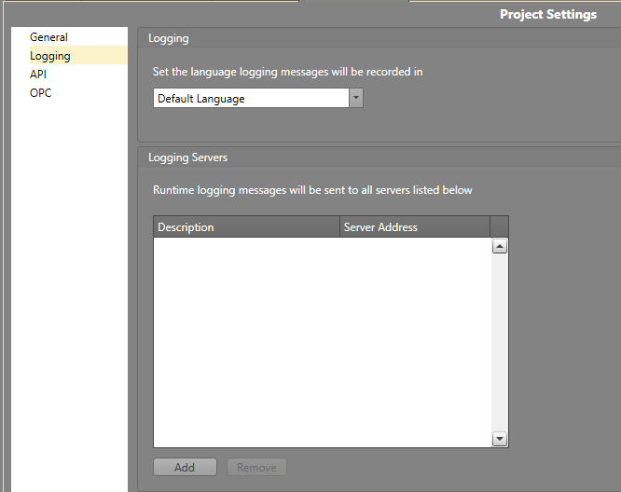
Project Settings
Logging
  Set default language used for logging
  Add logging servers to project

Slide 23
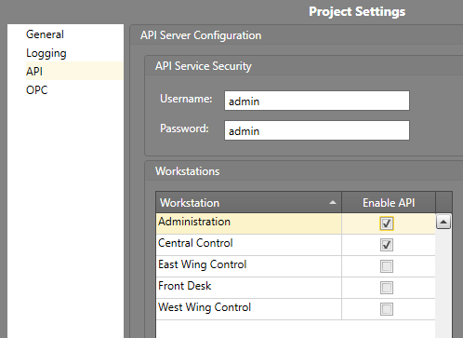
Project Settings
API
  Enable API server for individual Workstations
  Set up API login information

Slide 24
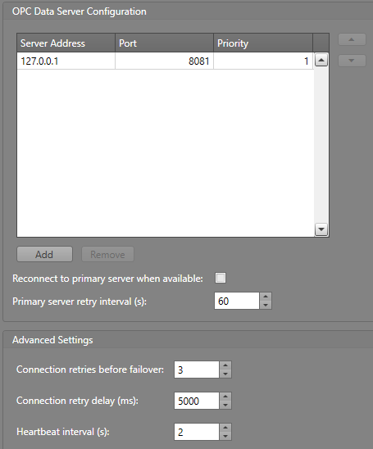
Project Settings
OPC
  Set global OPC data server communication parameters
  Individual integrated systems can override these settings
  Multiple prioritized servers allow for failover

Slide 25
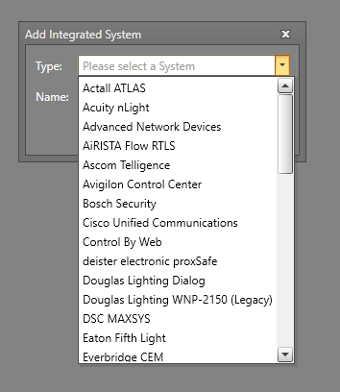
Add Integrated System
  Used to add new integrated systems to the project

Slide 26
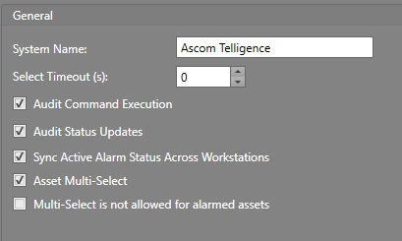
Integrated System – General
System Name — Unique name for system
Select Timeout — Number of seconds the system will keep assets selected (set to 0 to disable timeout)
Audit Command Execution —Log executed commands
Audit Status Updates — Log when an asset status is updated
Sync Active Alarm Status Across Workstations— Communicate asset alarm states between Workstations
Asset Multi-Select— Multiple assets from this system may be selected at once
Multi-Select is not allowed for alarmed assets — When an asset is in an alarmed state, it cannot be multi-selected

Slide 27
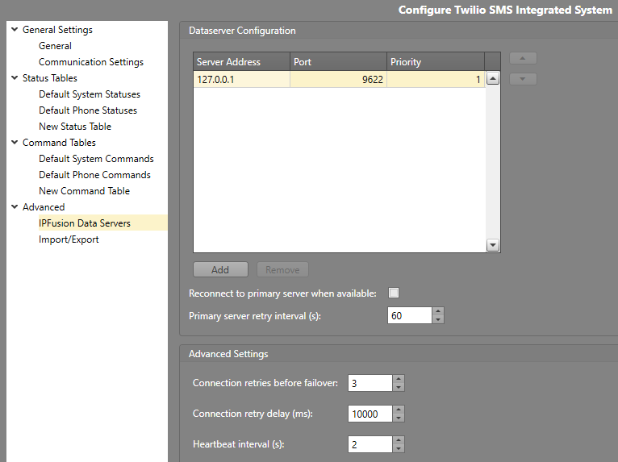
Integrated System – IPFusion Data Servers
Choose network location where the system driver will be running
  Driver facilitates connection between Runtime and the third-party integrated system
  Can be located on local machine, separate data server, or on the third-party system server
Leave as 127.0.0.1 if the driver will run on the local computer
Configure connection parameters

Slide 28
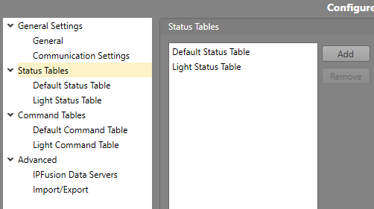
Integrated System – Status Tables
Add and configure status tables
Status tables translate real device states into visual icon representations

Slide 29
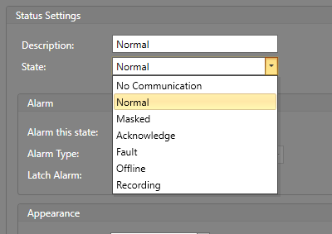
Integrated System – Status: States
Common States
  Acknowledge — an active alarm has been acknowledged
  Fault — an error reported by the driver
  No Communication — there is no communication with the driver
  Normal — asset is online and in its default state
  Masked — the asset has been masked over its true state
System Specific States
  Dependent on the system type
  Real device states reported by the driver (door unlocked, intercom connected, etc.)

Slide 30
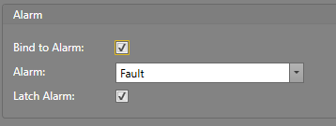
Integrated System – Status: Alarm
Bind to Alarm
  Configure this state to trigger an alarm in the alarm grid
Alarm Type
  Set the alarm type to display in the
  alarm banner when this alarm is triggered
Latch Alarm
  When checked, the alarm will only be cleared when an Acknowledge command and then a Reset command have been sent to it.

Slide 31
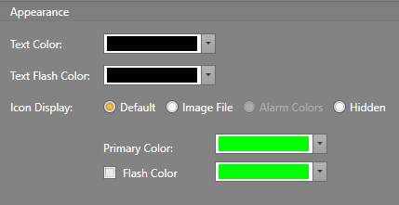
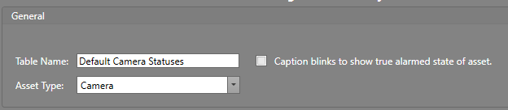
Integrated System – Status: Appearance
Text Color/Flash Color
  Configure caption color and
  flash color
Icon Display – Default
  Configure primary and flash
  color
Icon Display – Image File
  Display an image (and optional flash image) instead of the default icon
Icon Display – Alarm Colors
  Use the configured alarm colors for the icon
Icon Display – Hidden
  Do not display the icon or caption for this state
Caption blinks to show true alarmed state of asset
  Caption text will blink to show true alarmed state

Slide 32
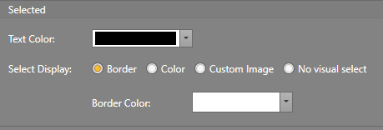
Integrated System – Status: Selected
Text Color
  Caption color to display
  when the asset is selected
Select Display
  Border – Display a border
  around the icon when the asset is selected
  Color – Change the color of the icon when the asset is selected
  Custom Image – Display a custom image instead of the icon when the asset is selected
  No visual select – Do not change the display of the icon when the asset is selected

Slide 33
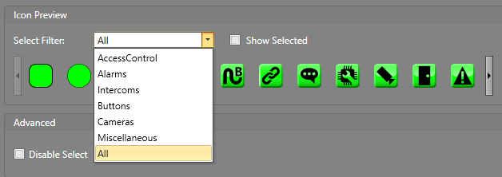
Integrated System – Status: Icon Preview
Shows icons with the
current state’s settings
applied
Allows user to preview
visual settings without the
need to launch Runtime
Select Filter
  Filters icon types displayed in the icon preview area

Slide 34

Integrated System – Status: Advanced
Disable Select
  Disable asset selection for this state

Slide 35
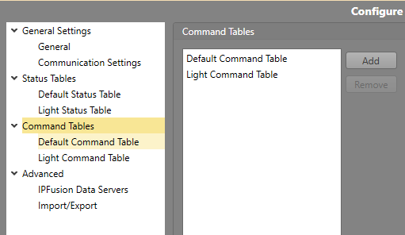
Integrated System – Command Tables
Add and configure
command tables
Command tables
translate command
names into driver
commands used to
control real devices

Slide 36
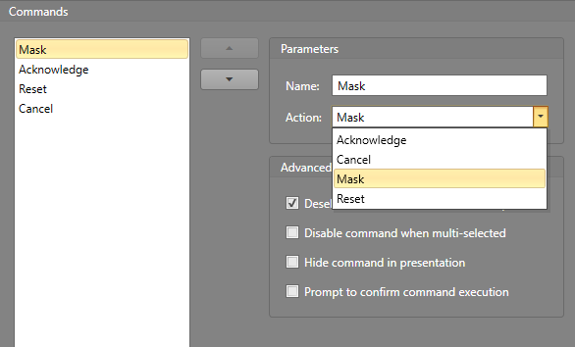
Integrated System – Commands: Actions
Chooses the
action that will be
sent to the driver
when each
command button
is pressed
Defaults contain
all available
commands and
can be customized
to project needs

Slide 37
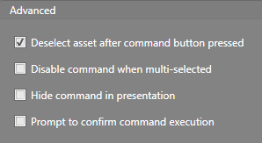
Integrated System – Commands: Advanced
Deselect asset after command
  Deselect the currently selected
  asset when the command button is pressed.
Disable command when multi-selected
  This command will not be available if more
  than one asset is selected at the same time.
Hide command in presentation
  Do not show this command in the command popup or function panel
  Allows workflow integration of commands between systems without exposing these commands to the user.
Prompt to confirm command execution
  Prompts the user in Runtime to confirm they want to execute the command.

Slide 38
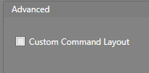
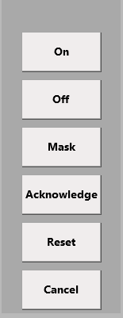
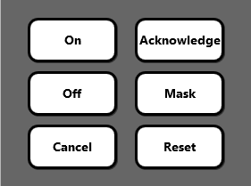
Integrated System – Commands: Advanced
Custom Command Layout
  Customize the display of command
  buttons in the popup or function panel
  If left unchecked, the commands will simply be displayed as a list of buttons
  If checked, the entire popup or function panel can be customized similar to designing a display layout (position, size, look of buttons as well as adding custom drawing objects)
Default
Customized

Slide 39
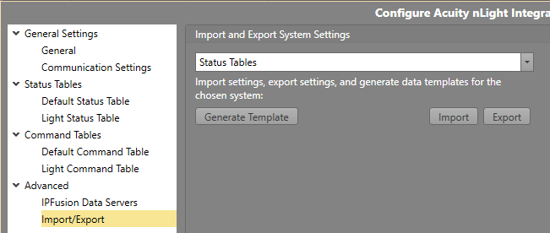
Integrated System – Import/Export
Import or export a .csv file that contains various data settings of the integrated system: Status/Command tables, and the configured assets and their properties.
Generate Template

Slide 40
Alarms

Slide 41

Home Tab – System Configuration
Alarm Management
  Configure alarm types
  Configure alarm postings

Slide 42
Maps

Slide 43

New Map
Add new Maps to the project

Slide 44



Toolbox
Add new assets to Maps
Add new control items to Display Layouts
Add new blocks to Workflows

Slide 45



Project Assets
Central management of all assets
Provides search, sort and filter
Can update properties

Slide 46

Properties Grid
Configure properties for the selected object including assets, screens, Workflow blocks and drawing objects.

Slide 47

Properties – Asset
Custom Properties
  Add a number of user defined custom value properties for the asset.
Logging Description
  If this string is present it will be used as the logging location for commands and statuses associated with this asset. If it is empty, the asset’s caption will be used for logging.

Slide 48

Properties – Camera Callups
Camera Callups
  Add cameras to the list of cameras associated with the asset for use in Workflows

Slide 49

Properties – Caption
Caption
  Text displayed on screen with icon
  Used for logging if Logging Description is empty
Font
  Customize caption font
Is Caption Displayed
  Show caption on screen with icon
Is Caption Rotated
  Rotate caption when icon is rotated
Relative Location
  Position of caption relative to icon
Relative Position X/Y
  Manually adjust caption position relative to icon center

Slide 50

Properties – Caption Background
Enables placement of a background color behind the caption to enhance readability
Border Width
  Number of pixels to extend background beyond caption
Color
  Color of caption background
Show
  Show caption background

Slide 51

Properties – Core Asset Settings
Command Table
  Choose command table to show when the asset is selected
  Command table consists of a list of commands, configured by integrated system
Status Table
  Choose status table the asset will use to determine icon display and alarms
  Status table consists of a lookup table that translates system states into icon displays, configured by integrated system

Slide 52

Properties – Integrated System
Integrated System
  Choose integrated system
  Can only choose between systems of the same type
Integrated System Type
  Displays system type (read only)

Slide 53

Properties – Layout
Disable touch in Runtime
  Check to disable asset touch
Display Icon
  Choose icon to display for asset
Configure drop shadow settings for asset and caption separately
  Blur Radius – “fuzziness” of drop shadow
  Color – drop shadow color
  Opacity – drop shadow opacity (transparency)
  Shadow Depth – distance between asset/caption and drop shadow
X/Y/Width/Height/Rotation Angle
  Set size, location and rotation of asset
Icon Touch Area (%)
  Used to extend icon touch area beyond the visible portion of the icon
Select Border Width
  Set the width of the visual border used to indicate a selected asset icon

Slide 54
Display Layouts

Slide 55
Project Explorer – Display Layouts
Add or Edit Display Layouts

Slide 56


Home Tab – Layout Assignment
Layout Assignment
  Assign the display layouts
  Set which display layout appears on each monitor for every Workstation
  If multiple Workstations have the same configuration, the same layout can be used for them, otherwise they will require their own dedicated Workstation Layout

Slide 57
Design Tools

Slide 58

Design Tab – Alignment
Aligns and distributes multiple objects
Selected objects will be aligned relative to the object with the blue border

Slide 59


Design Tab – Order
Change z-order of selected assets (moves selected objects in front of or behind other objects)

Slide 60

Design Tab – Grid
Snap to Grid – force objects to align with grid lines
Show Grid – show the grid lines
Grid Spacing – set the number of pixels between grid lines
Grid Color – set the color of the grid lines

Slide 61


Design Tab – Drawing
Add drawing shapes, labels and images to a screen, template panel or custom popup

Slide 62
Design Tab – Drawing
Rectangle – basic rectangular shape
Ellipse – basic elliptical shape
Line – basic line (point to point)
Polyline – line with multiple segments, drawn by clicking on the nodes (segment end points)
Polygon – basic polygonal shape. The number of sides can be set within the properties grid
Label – text box with fully customizable text properties
Image – image container, can select file to display as well as stretch mode

Slide 63


Design Tab – Asset Icons
Show Touch Areas
  Displays asset touch areas when configured to be larger than the icon size (>100%)

Slide 64

Design Tab – Asset Icons
Position Caption
  Configure custom caption position
  Useful when icon spacing is limited

Slide 65

Design Tab – Asset Icons
Locked Opacity
  Configure the opacity of locked item groups.
  Assets and Drawing items can be locked in order to prevent any selection and changes to them.
  Reducing the opacity of these locked items can lessen visual clutter on maps when editing.

Slide 66
Runtime

Slide 67

Home Tab – Runtime
Run
  Launch the current project in the Runtime application

Slide 68

Home Tab – Runtime
Simulate
  Launch the current project in the Runtime application in simulation mode

Slide 69
Version Control

Slide 70

Overview – Version Control
Allows you to create a repository to track project changes
  Commit new changes
  Sync changes made to repository
  Revert to previous versions
Repository can be located on local machine or on remote server

Slide 71

Home Tab – Version Control
Project Browser
  Accessible once connected to a Repo

Slide 72

Home Tab – Version Control
Commit
  Saves the current project changes to the local repository
  Commits will be sent to remote once they are synched

Slide 73
Home Tab – Version Control
Sync
  Syncs current project with the remote
  Removes any changes that have not been committed

Slide 74

Home Tab – Version Control
Version History

Slide 75
Publication

Slide 76


Home Tab – Publication
Publish Project
  Copies the current project to Workstation
  Shows current status of each Workstation’s published project (white = current, red = outdated/fault)
  If required, Runtime will restart
  When Runtime.exe is launched, Runtime will load the most recently published project

Slide 77
Find

Slide 78


Home Tab – Search
Find
  Find specific strings throughout the project
  Advanced searching with regular expressions

Slide 79
Layout

Slide 80

View Tab – Layout
Reset Designer Layout — Sets layout back to default settings

Slide 81
Security

Slide 82


Home Tab – Security

Slide 83
Language Manager

Slide 84


Home Tab – Edit Language

Slide 85
Module 2 Complete

