Slide 1
Module 4
Advanced Features:
Workflows

Slide 2
Overview

Slide 3
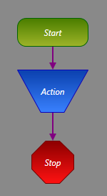
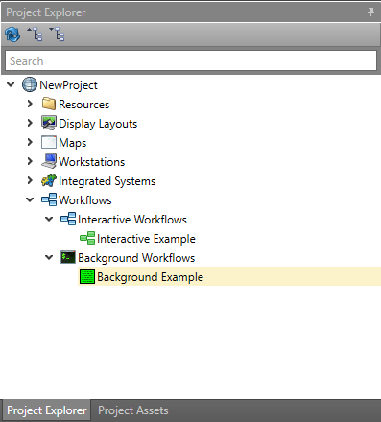
Overview
Standard Operating Procedure (SOP)
  Respond and handle situations consistently
Triggered by events (or conditions)
Design is similar to Maps (design tab, toolbox, etc)

Slide 4
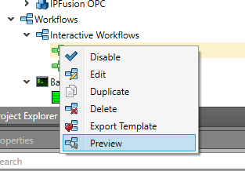
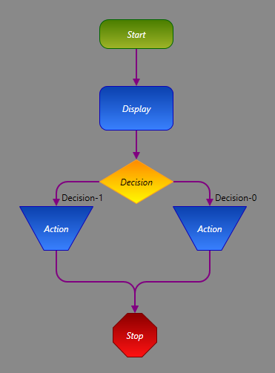
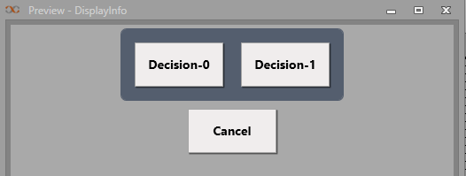
Overview – Interactive Workflows
Launches in popup or function panel
Can only be used in graphical Runtime
Interaction with user (display text, images, files, prompt for choices)
Can be previewed from right-click menu (Workflow must be saved first)

Slide 5
Overview – Background Workflows
Launches in background
Performs operation only, no interaction with user
Single execution / high availability

Slide 6
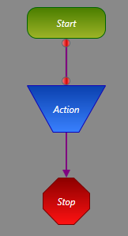
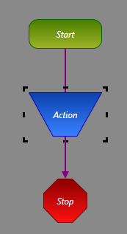
Design – Blocks & Connections
Blocks
  All functions in a Workflow are performed by blocks
Connections
  Connections are followed from Start to Finish in a logical order
  All connections must be valid, or the Workflow cannot be enabled
  When the Workflow is invalid, connections are red. When valid, they are purple
Connection
Block

Slide 7
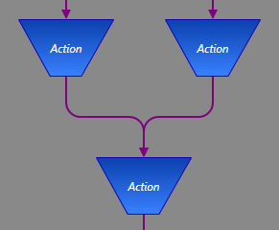
Design – Blocks & Connections
Blocks have one entrance point and a set number of exit points, depending on the block type
Entrance points can accept multiple paths
Exit points can only go to one path
Two paths to
one entrance point

Slide 8
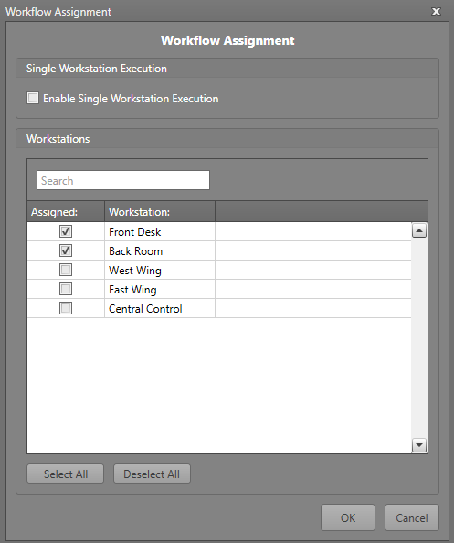
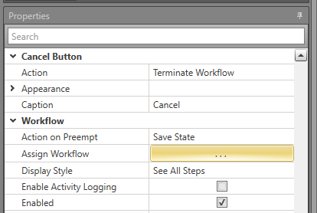
Design – Assigning Workflows
Selectively assign Workflows to Workstations
All, none, or specific Workstations
Can execute on a single Workstation when assigned to multiple

Slide 9
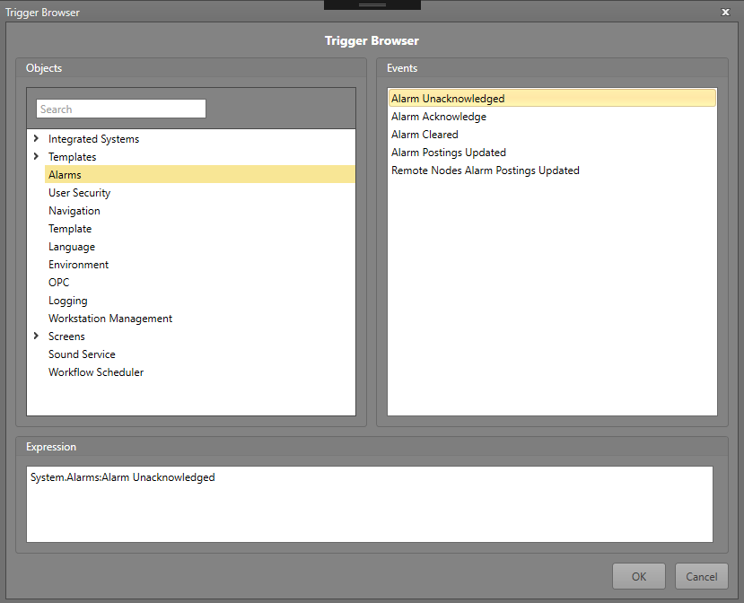
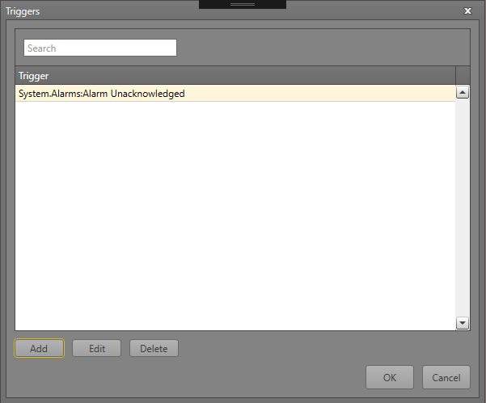
Design – Defining Triggers
Use Trigger Browser to define which events will trigger the Workflow
Can add multiple triggers

Slide 10
Common Blocks

Slide 11
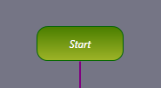
Common Blocks – Start
Each Workflow must contain one, and only one, Start block
Logical flow begins here when the Workflow is triggered

Slide 12
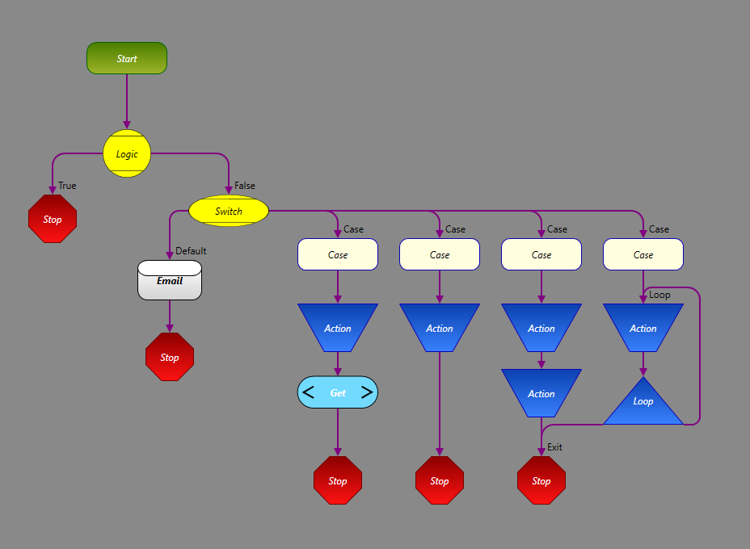
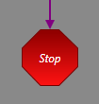
Common Blocks – Stop
Each Workflow must contain at least one Stop block
Logical flow ends here
Possible to use multiple Stop blocks in order to clean up the appearance of the Workflow (larger Workflows can be complicated)

Slide 13
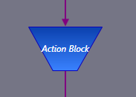
Common Blocks – Action
Performs an action which is chosen from the Action Browser
Parameters are passed to the action using the Object Browser

Slide 14
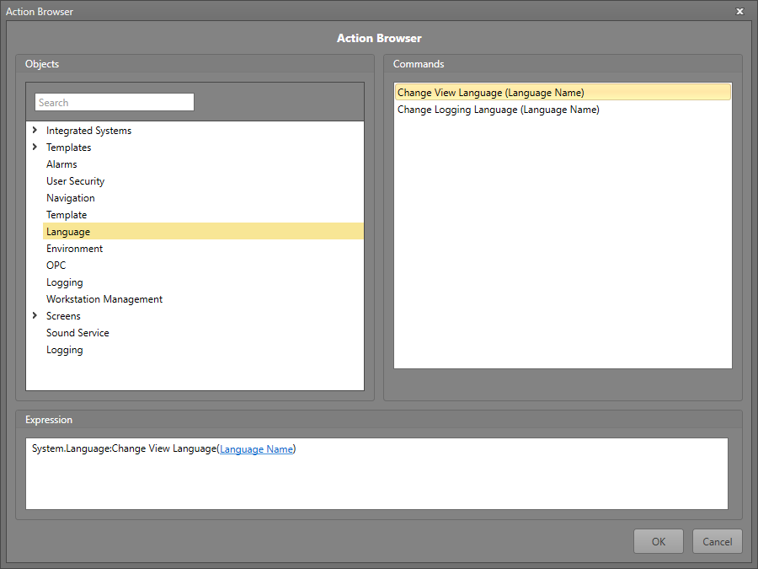
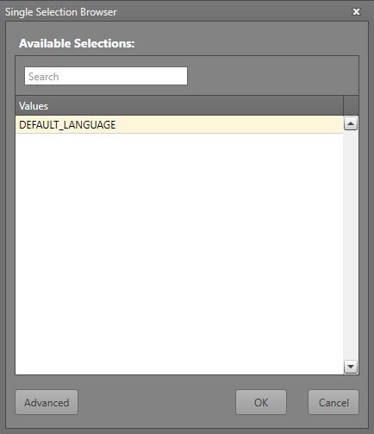
Common Blocks – Action

Slide 15
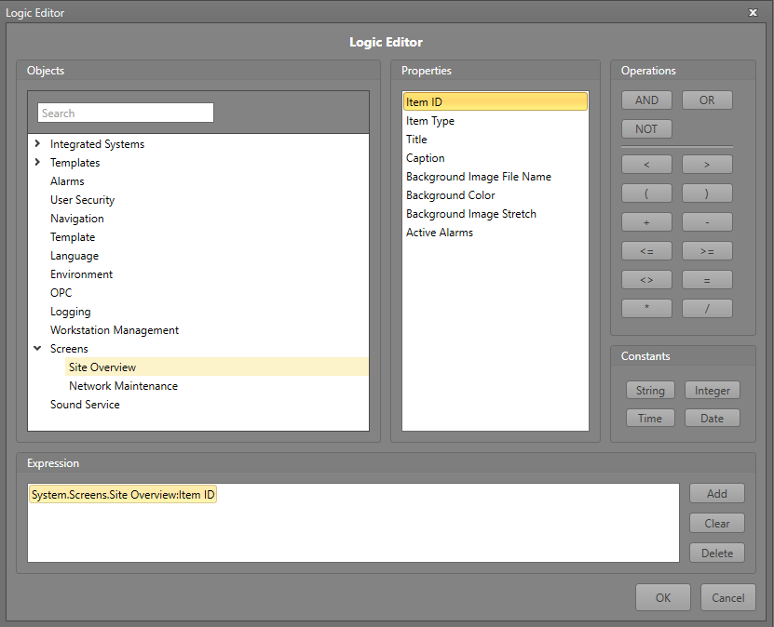
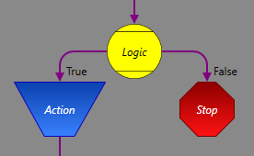
Common Blocks – Logic
Evaluates a logical expression, built with Logic Editor
Chooses left path if true, right path if false

Slide 16
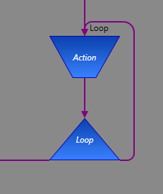
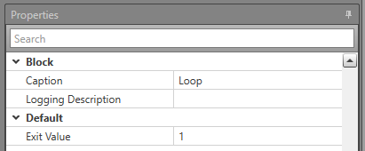
Common Blocks – Counter Loop
Loops through the same logic until the exit value is reached
Used to repeat sections of logic a set number of times
Left path is exit, right path is loop

Slide 17
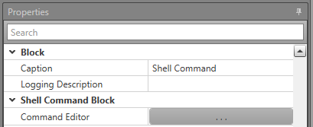
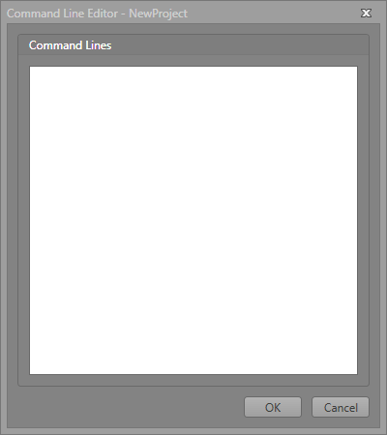
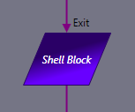
Common Blocks – Shell
Executes shell script, defined in Command Editor
Used to interact with Windows environment outside of Runtime (start external application, etc)

Slide 18
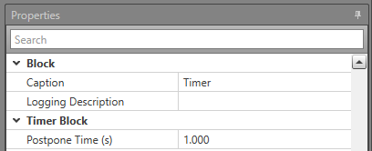

Common Blocks – Timer
Delays execution of the Workflow by a set number of seconds

Slide 19
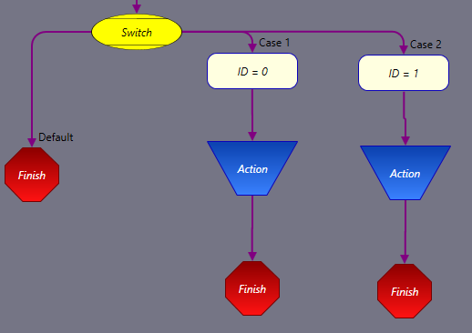
Common Blocks – Switch Case
Execute a sequence of blocks if a logic expression matches one of the specified cases.
Left section is the default path where no case matches.

Slide 20
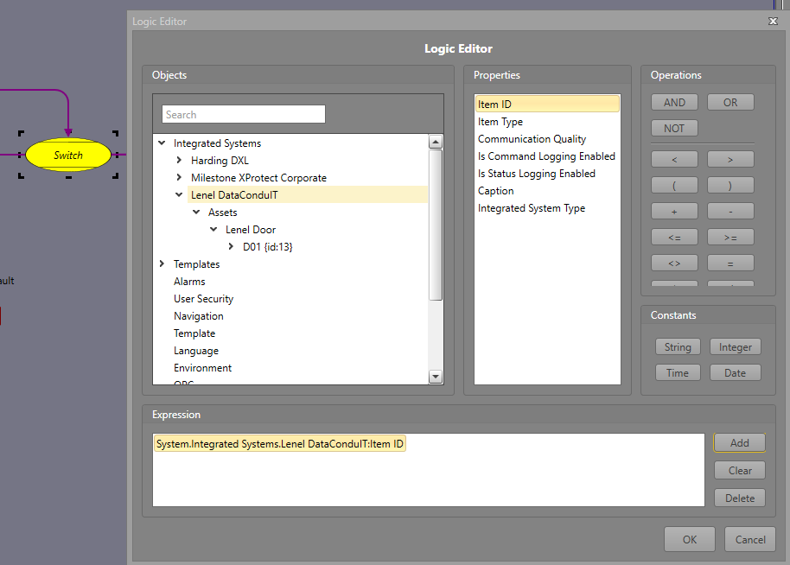
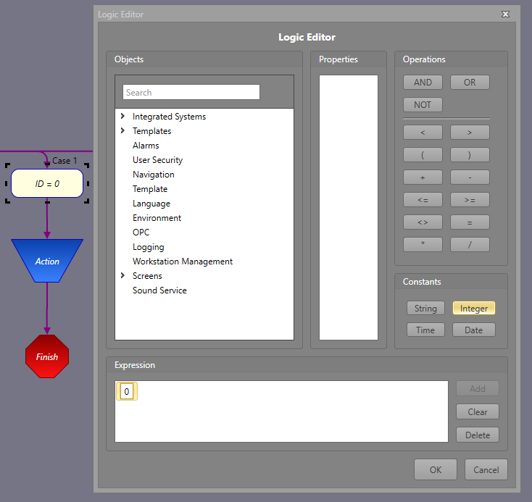
Common Blocks – Switch Case

Slide 21

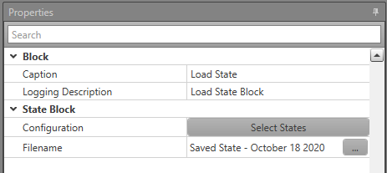

State Blocks
Save or load specific states of various IPFusion entities.
The states are saved in a file and users will need to input the filename which the block will use to save as or load from.

Slide 22
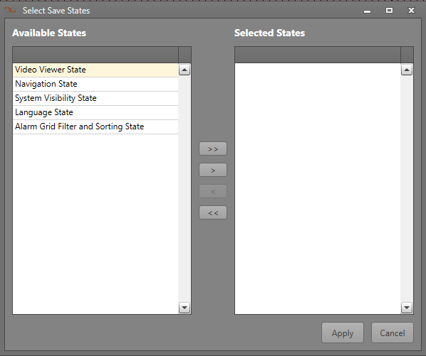
State Blocks
Video Viewer State — Will save or load all the viewer IDs and the camera asset Ids that are playing in them.
Navigation State — Saves or loads all the Map IDs that are currently displayed in the Map Container.
System Visibility State — Saves or loads the state (pressed or not) of the System Visibility buttons. displayed on each Map Container.
Language State — Will save or load the currently used Runtime language.
Alarm Grid Filter and Sorting State — Saves or loads the sorting and filtering applied to Alarm grids in Runtime.

Slide 23


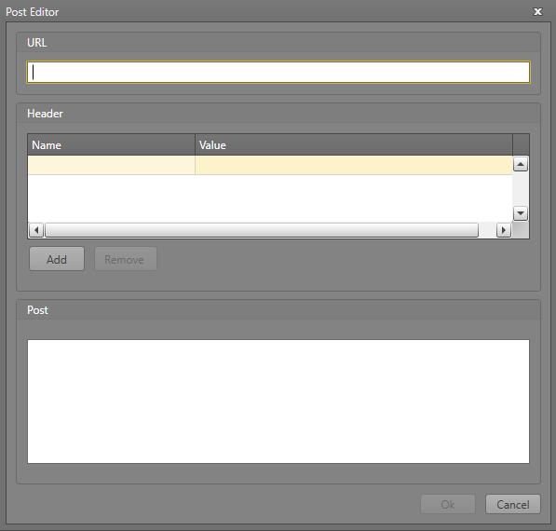
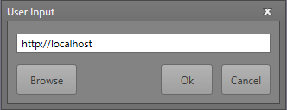
HTTP Blocks
A Get block is used to perform an HTTP Get request from a specified URI.
A Post block provides facility to do a rest HTTP Post request using configured settings.

Slide 24

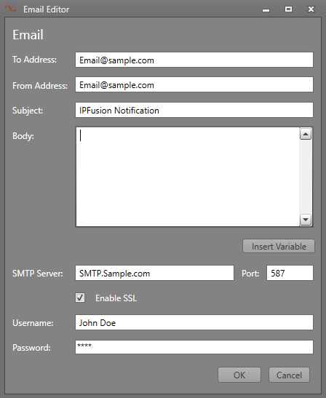
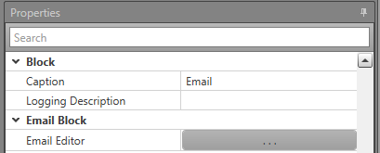
Email Block
Used to send plain text email messages to a recipient.
Specify the needed information and settings in the Email Editor.

Slide 25
Interactive Workflows

Slide 26
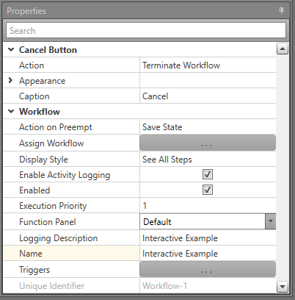
Interactive Workflows
Fully customizable from properties

Slide 27
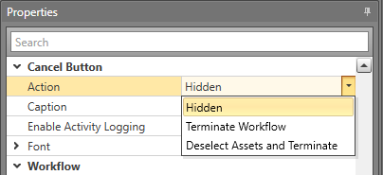
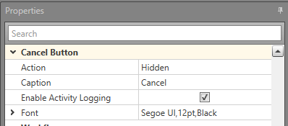
Interactive – Cancel Button
Hidden – Hides Cancel Button.
Terminate Workflow – Closes the Workflow.
Deselect Assets and Terminate – Closes the Workflow and deselects all assets.
Font – Define font used for Cancel Button caption.

Slide 28
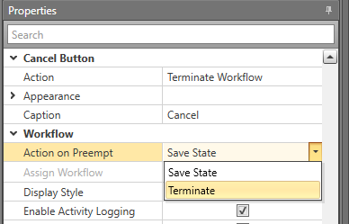
Interactive – Action on Preempt
Save State — When the current operating Workflow is completed and there is a Save State Workflow waiting, the highest priority one will run
Terminate — These Workflows can never be in a waiting state. If a higher priority Workflow begins operating, this one will be terminated.

Slide 29
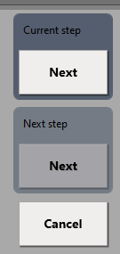
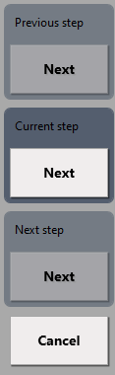
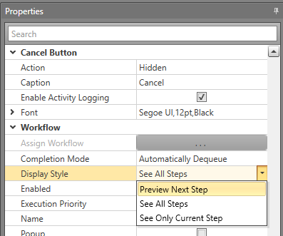
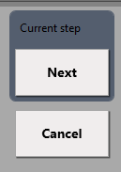
Interactive – Display Style
Preview Next Step – Displays the current and next steps, with current step highlighted.
See All Steps – Displays all steps, with current step highlighted.
See Only Current Step – Displays the current step only.
Preview Next
See All
See Current

Slide 30
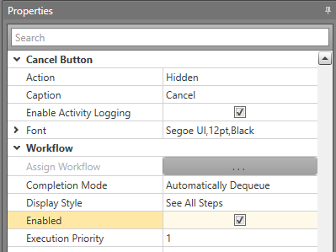
Interactive – Enabled
Can only run Workflow when this option is checked, and all logic paths are valid
Can be unchecked to disable Workflows that are no longer required, or that are not ready for production yet (useful during design phase).

Slide 31
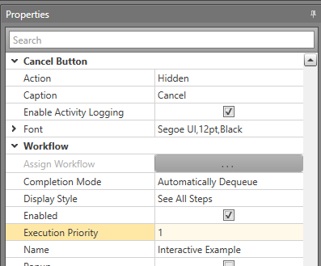
Interactive – Execution Priority
Only one interactive Workflow can run at a time.
This property defines which will run first (lower number = higher priority)

Slide 32
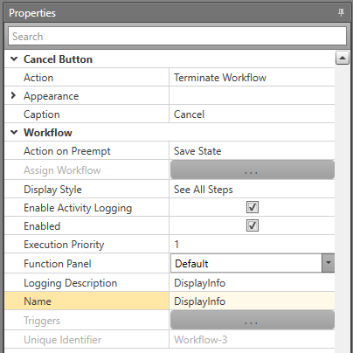
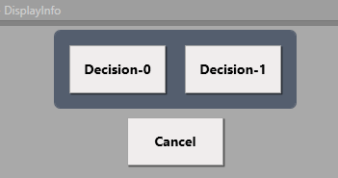
Interactive – Name
Defines title that shows in the Workflow header in Runtime

Slide 33
Interactive Blocks

Slide 34
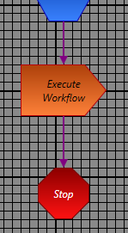
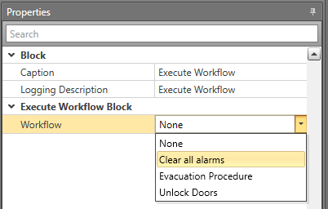
Interactive Blocks – Execute Workflow
Triggers another Interactive Workflow
  Configure the Workflow property to specify which one to execute
Exit path can only be connected to a stop block

Slide 35
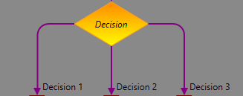

Interactive Blocks – Decision
Prompts the user for a decision (button press)
Button text defined by exit paths
Button order defined by order of path creation
Button appearance customized in properties

Slide 36


Interactive Blocks – Decision
Unlimited exit paths can be created

Slide 37


Interactive Blocks – Display
Simple text or image display, used to provide information to the user.
Runtime Title – Title displayed in Runtime.
Display Text – Text to display.
Advance on Press – Check to add a button that the user must press to advance to the next block.
Image Path – Choose an image to display along with text.
Display Order – Choose to display the image (if configured) either above or below the text

Slide 38


Interactive Blocks – File
Similar to a Display block but can display any resource file, not just an image.

Slide 39


Global Workflows
Trigger from any of the Assets in an Integrated System
Apply logic, actions to Triggering Item
Current vs Initial State
Rule of thumb: Choose initial state unless current is required

Slide 40
Module 4 Complete

