Slide 1
Module 5
Advanced Features:
Publication

Slide 2
Overview

Slide 3
Overview
Allows central management of configuration.
One project, edited on the publication server (typically the logging or maintenance server), published to remote Workstations for production.

Slide 4
Publication Server

Slide 5
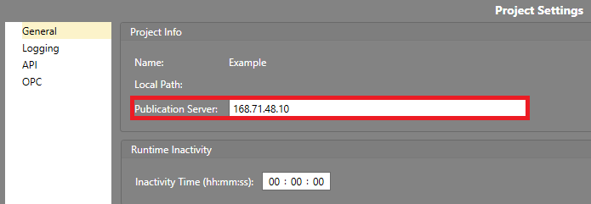
Publication Server
The server which publishes the new project version to Workstations
Configured in General Project Settings
Notes:
Insert screenshot here

Slide 6
IPFusion Publication Service

Slide 7
IPFusion – Project Publication
Windows service installed with IPFusion
Required for publishing
Communicates if the Workstation is available for publication

Slide 8
Publication Window

Slide 9
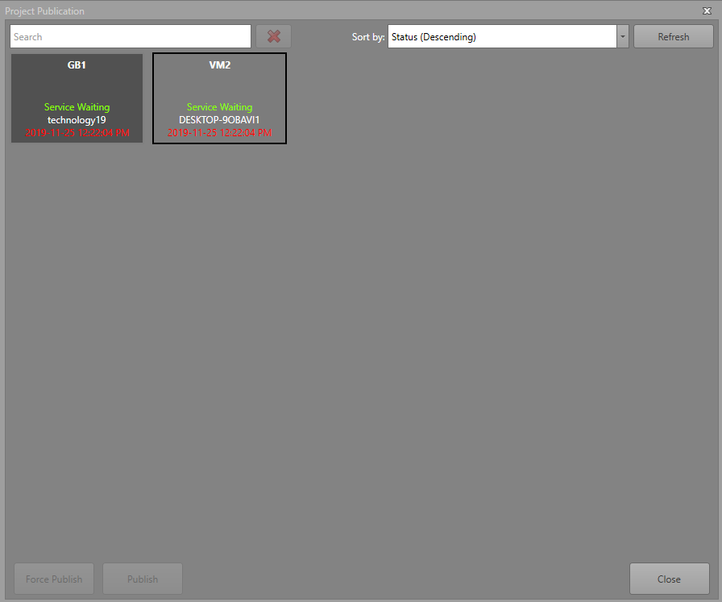
Publication Window

Slide 10
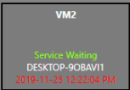
Publication Window — Workstation Block
Name of the Workstation
Sync Service States
  Green — Service is waiting
  Yellow — Update in Progress
  Red — Service not found
IP Address of the Workstation
Last Published Time
  The color of the date shows the current status of the files
    Red — The last time the files were published to
    White — Published a new update at this time

Slide 11

Publication Window — Publication Buttons
Publish
  Publish the project files to the selected Workstation.
  When the Workstation receives the update, it will prompt the operator to accept the change.
Force Publish
  When the Workstation receives the update, Runtime will automatically update the project files regardless of user input.

Slide 12
Publish a Project

Slide 13
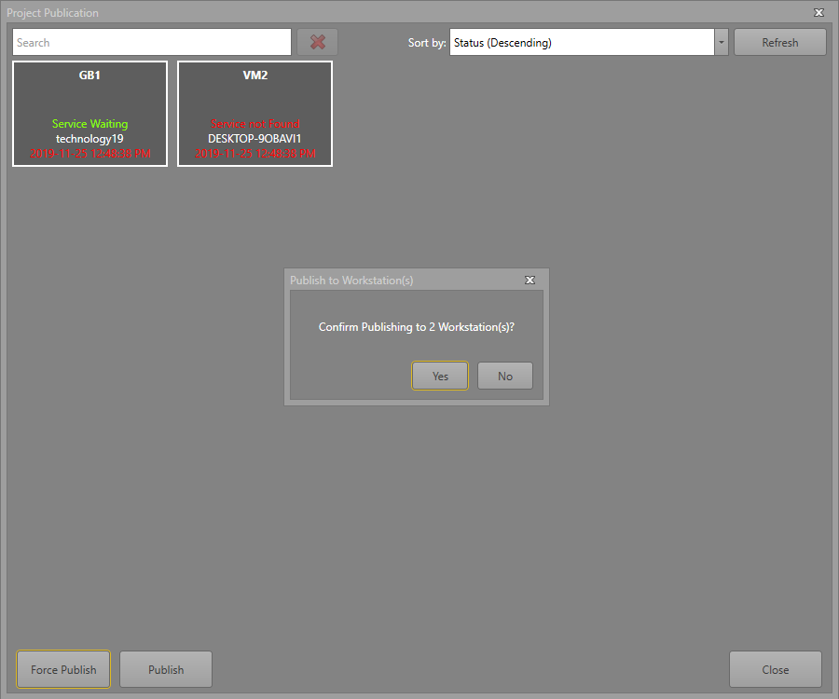
Publish a Project
Click Publish Project in Designer
Select the Workstations to include in the publication request
  Press Ctrl + A to include all Workstations
Select Publish or Force Publish
If the Publication Service is running on the Workstation, its files will be updated accordingly
When started, Runtime will automatically load the most recently published project received

Slide 14
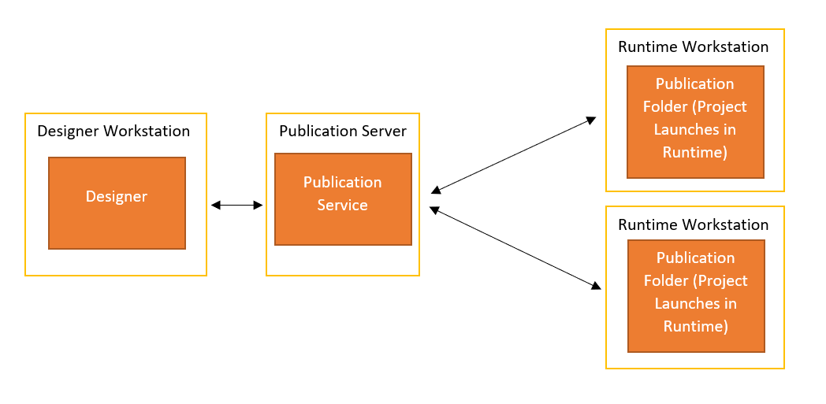
Example

Slide 15
Module 5 Complete

