Slide 1
Module 6
Advanced Features:
Runtime as a Service

Slide 2
Overview

Slide 3
Overview
Headless Runtime execution
No graphical representation on Workstation
Run Background Workflows
Use for:
  API-only control of Runtime
  Building automation
  Run processes without Workstation operator interaction

Slide 4
Setup

Slide 5
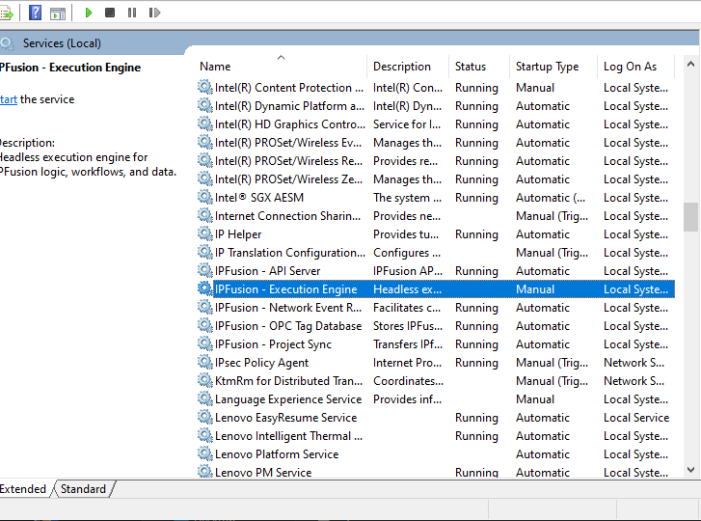
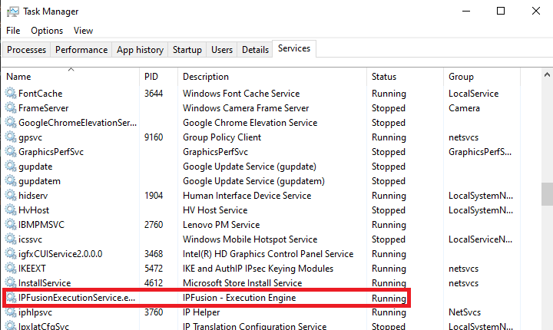
Setting up Runtime as a Service
In Windows, navigate to Services
Start the IPFusion – Execution Engine service.
  Note: To start with Windows startup, right-click the service and select Properties. Set the Startup type to Automatic (Delayed Start).
Open Task Manager to confirm the service is running.

Slide 6
Troubleshooting

Slide 7
Troubleshooting
Check the Windows event logs for errors.
Logs contain information as to why it was unable to start.

Slide 8
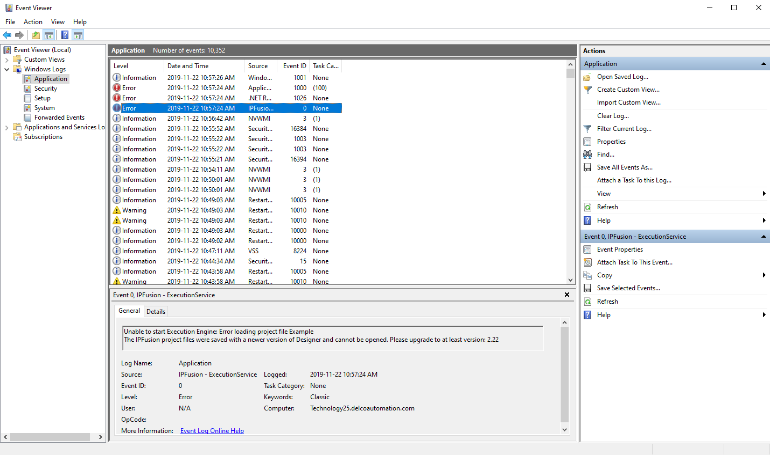
Troubleshooting Error — Example

Slide 9
Using Runtime as a Service

Slide 10
Using Runtime as a Service
Runs Background Workflows
Handles API requests
Publication process:
  Determines if Execution Manager needs to be restarted
  End user does not need to complete extra steps for publication
Note: Only the graphical Runtime or the service can be active at once. They can not be run at the same time.

Slide 11
Module 6 Complete

