Slide 1
Module 7
Advanced Features:
Logging and Reporting

Slide 2
Overview

Slide 3
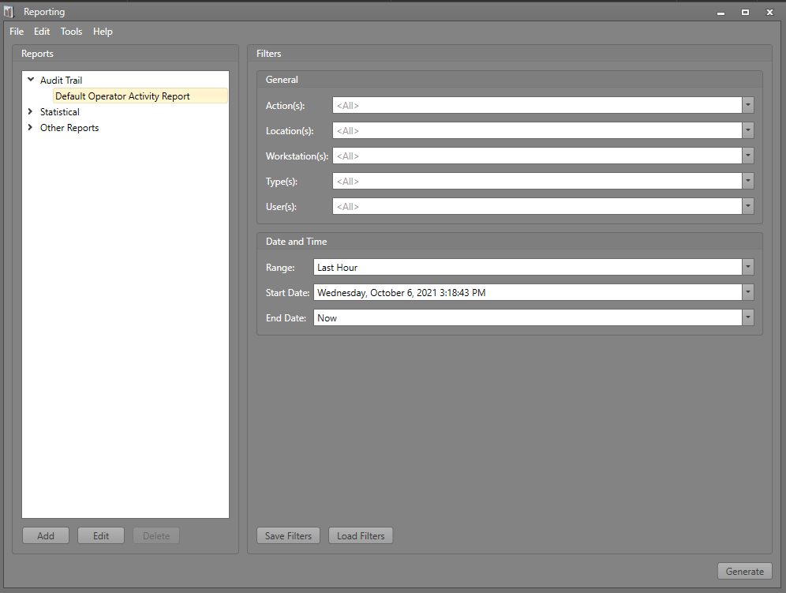
Overview
The IPFusion Logging and Reporting Application allows the logging and generation of data about the activities in the software.
It uses the Logging driver using Microsoft Message Queueing and SQL Server.
With this app, system events and user actions can then be monitored and archived.

Slide 4
Installing the Logging Database and Software

Slide 5
Installing the Logging Database and the Application
Install a version of the Microsoft SQL Server database in the main logging server/Workstation
  Minimum version is SQL Server 2012 R2
  SQL Server 2017 can be installed by the Logging installer
Make sure that the SQL Server installation is correct by connecting to the database.
After installing the SQL Server Database, install the remaining Logging and Reporting components.

Slide 6
Installing the Software — Workstations
The Reporting application can optionally be installed with IPFusion.
To update the Logging server information, open the Reporting application and go to File > Options.
  Set the server IP address or host name
  Set the database name
  If the user you are logged is as does not have permissions to the SQL database, uncheck Trusted Connection and enter in the username and password for the SQL user.

Slide 7
Viewing Logs with the Reporting Application

Slide 8
Viewing Logs — Basics
All the logs created by the Workstations are grouped into reports.
Users can add and edit reports to filter out logs and data based on their needs.
Reports can then be generated which can be reviewed, printed, or saved as a file.
Upon starting the application there are some reports already created by default.
  Any changes to the format of the default reports will be discarded. Save the edits as new reports instead.

Slide 9
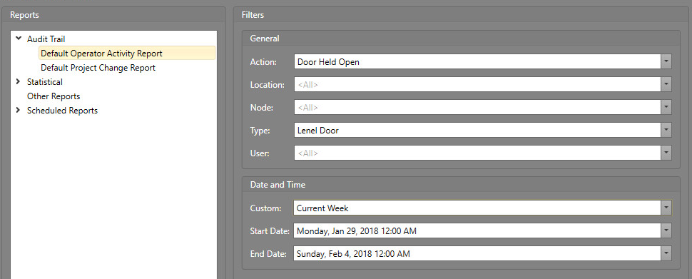
Default Operator Activity Report
This report is pre-configured to filter information in a generic security system.
The General section determines the fields that the report will filter the logs with.
Setting the fields in the Date and Time section will only obtain the specified logs from that time frame.

Slide 10
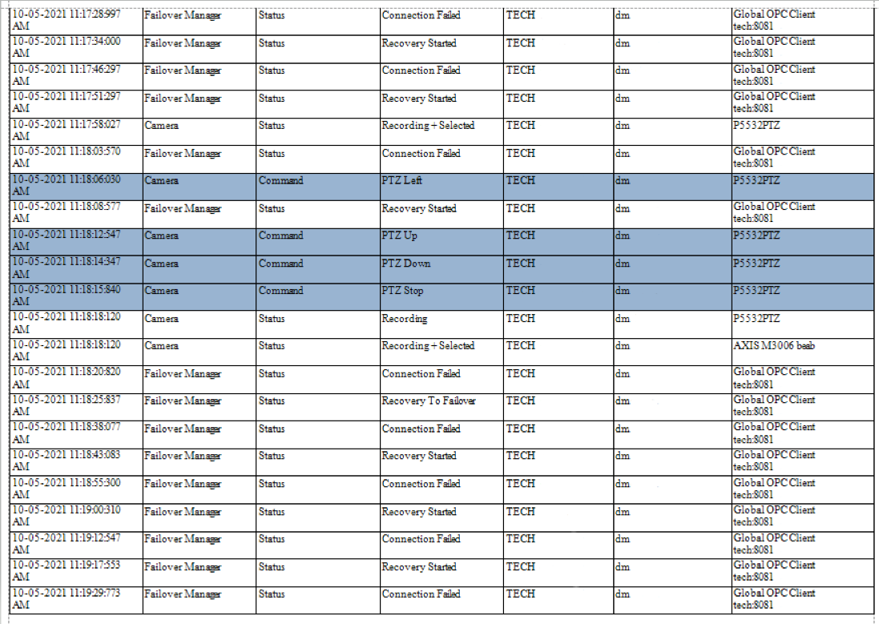
Generated Default Operator Activity Report example

Slide 11
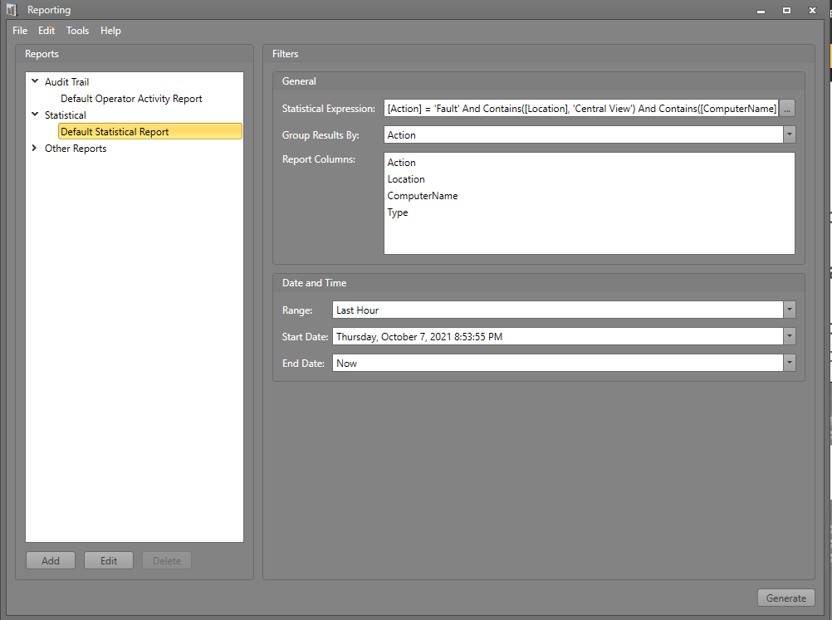
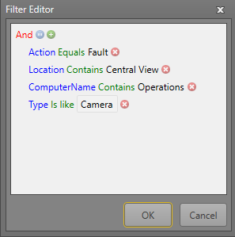
Statistical Reports
Statistical reports display the number of occurrences of similar events during project usage.
Add more filters/columns to the Statistical Expression to obtain the needed information.
Group the results by one of the criteria to cluster the data.
  All data that share the same group by criterion is one “Occurrence”.
Notes:
Update screenshots

Slide 12
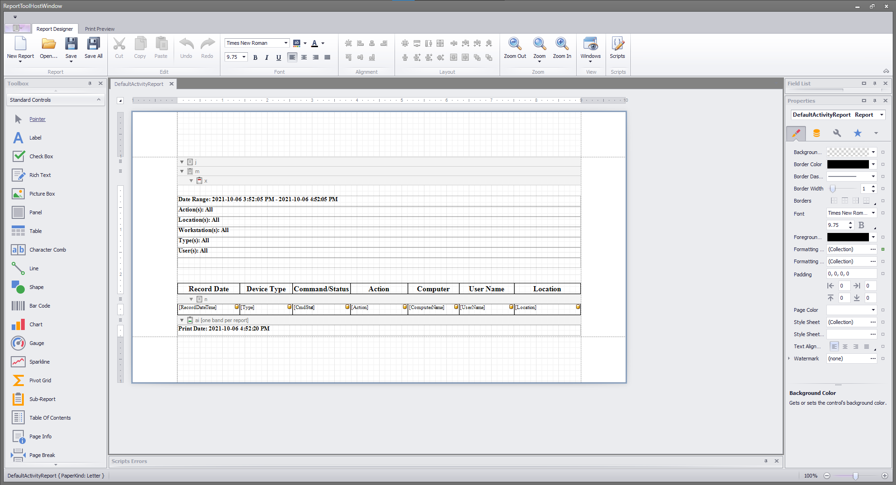
Creating and Editing Custom Reports
When creating new reports or editing existing ones, it will bring up the Report Tool Host Window.
This is where users can edit the look and data of the report sheets that the application will generate.

Slide 13
Module 7 Complete

