Slide 1
Module 8
Advanced Features:
Debug Tools

Slide 2
Overview

Slide 3
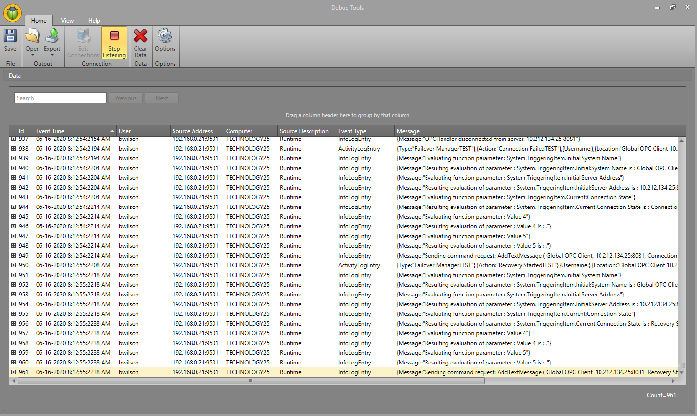
Overview
Assists in troubleshooting the project.
Connects to both Designer and Runtime, as well as to running drivers.
Shows all logging and debugging messages as you continue to work in the project.
Provides capability to filter and search live data.

Slide 4
Managing Connections

Slide 5
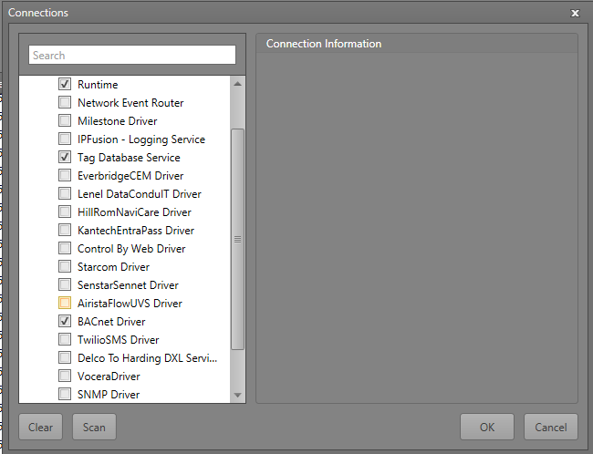
Managing Connections
Debug Tools can connect to many different entities.
Possible to connect to multiple running processes at one time.
Multiple logs from different sources can be confusing. Use filtering.
Add or scan for the connections to observe.
Added and scanned connections are automatically saved.

Slide 6
Filtering Live Data

Slide 7
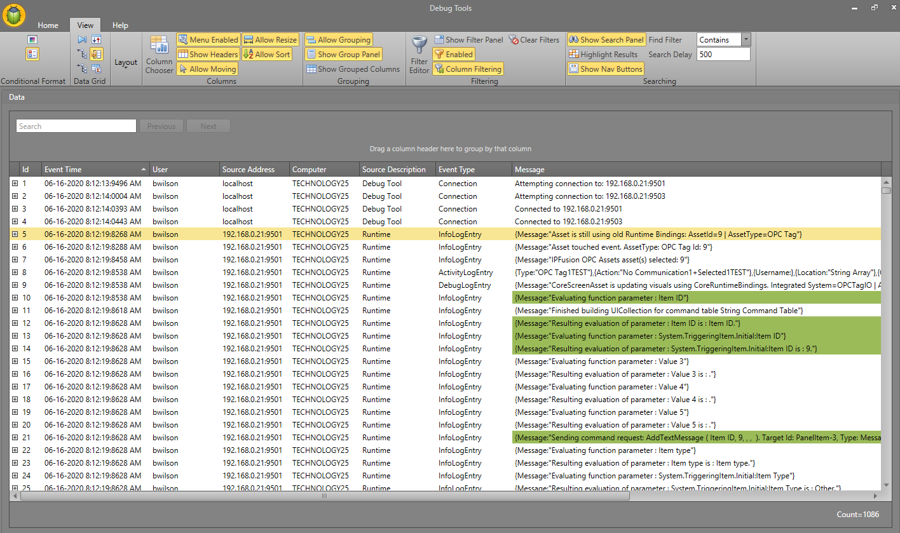
Filtering Live Data
Debug tools offer many options to filter the data incoming.
Adding filters, formatting rules, and searching for specific strings.

Slide 8
Searching the Data
Search for specific text strings to filter the logs.
Able to change the Search Filter formula and add different highlighting options to make traversing the search results easier.

Slide 9
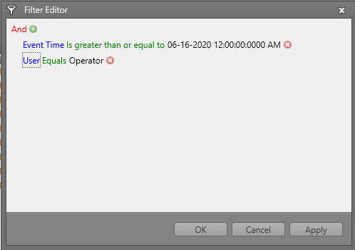
Filter Editor
Create filter rules so as soon as the data is read, only the logs that satisfy the filter show.
Can add multiple filters to create very specific conditions.

Slide 10
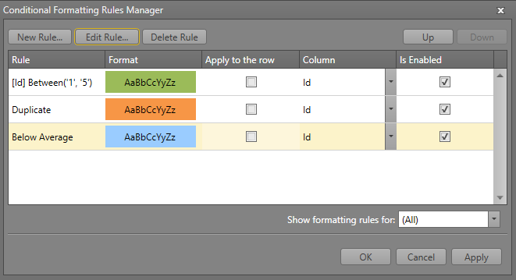
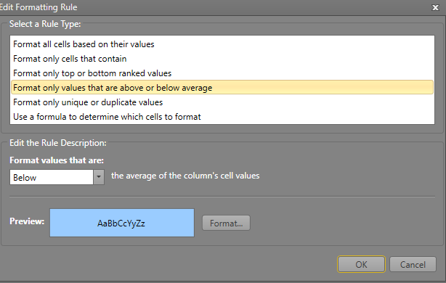
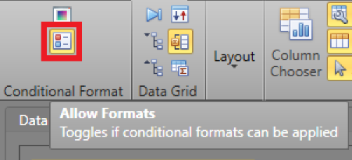
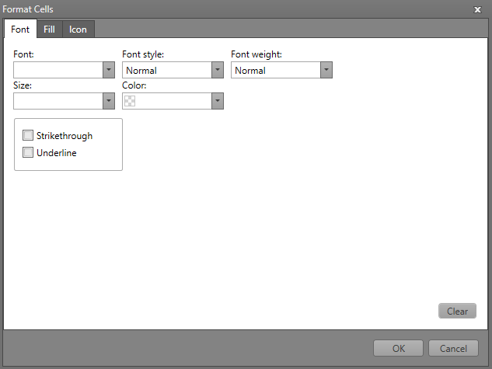
Formatting Rules
Add formatting to the rows of logging entries to make them distinguishable.
Create rules which will determine what entries get the format.
Apply a series of different formats: font properties, fill color, or an icon.
Select if the format will be applied to the whole row or just a specific data column.

Slide 11
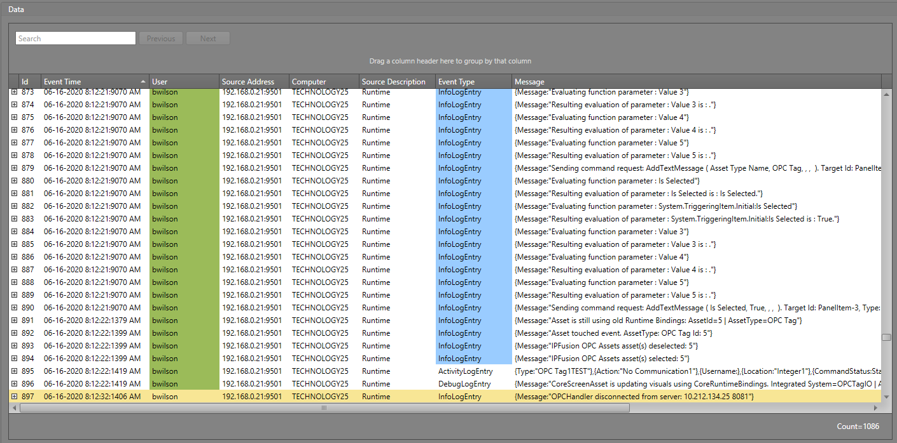
Formatting Rules: Result

Slide 12
Customizing Live Data Layout

Slide 13
Customizing Layout
The live data area can be customized to include row lines, additional data columns, log count summaries, and grouping similar data together.
Show simple layout options like a row indicator, and horizontal and vertical column lines can be enabled.
Pressing the Reset option reverts all changes back to default settings.
Alternate Row Count and Color are not implemented.

Slide 14
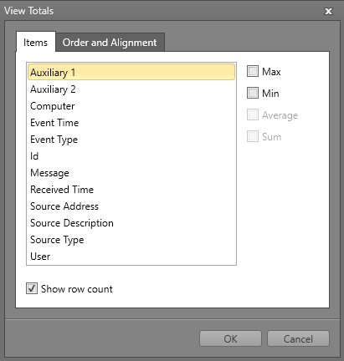
Customizing Layout – Data Grid
Show the newest data rows at the top.
Expand or collapse the displayed information in each row.
Show or hide a navigation panel and a summary panel.
Summary panel can be edited to show the what data is logged the most and the least.
Navigation and Summary Panels

Slide 15
Customizing Layout – Data Grid
Rows can be viewed either collapsed or expanded
The expanded format can provide further information

Slide 16
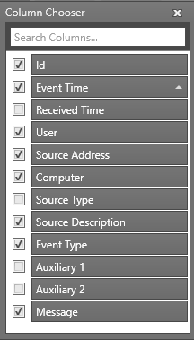
Customizing Layout: Columns
Customize the columns section of the live data area.
Show or hide headers, and enable or disable column moving, resizing, and sorting.
Can also add additional columns to display more information.
Column Moving must be enabled to do this.

Slide 17
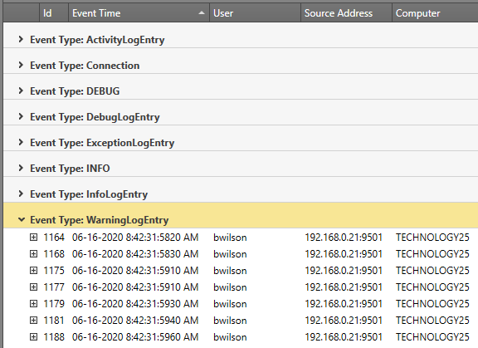
Customizing Layout: Grouping
Can also group columns together to display data in a specific organized fashion.
Can group multiple columns together as well.

Slide 18
Saving and Loading Layouts

Slide 19
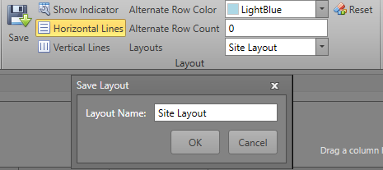
Saving and Loading Layout
Alongside the formatting rules and filters, the column, grouping, and navigation and summary panel data settings can be saved and loaded as a layout .xml file.
Utilize different layouts and formats depending on the project and your preferences.
Note: Visibility and Allow properties are saved via the application.
When you open the application next time, it will remember these settings.

Slide 20
Exporting

Slide 21
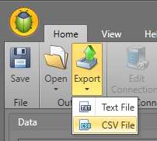
Exporting Logs
The current logs and data can both be printed or exported as a separate file (txt or csv).
Use these tools to create records of logs that can easily be referenced and looked into by integrators and developers.

Slide 22
Saving to File

Slide 23
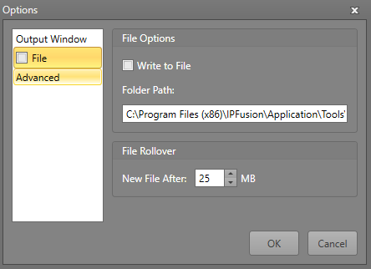
Saving to file
Instead of live capturing the data, the logs can be saved to a file.
Select and add the necessary information in the Options window.
Useful if you cannot actively look at the data at the same time but still want to continuously log all the activity and debugging messages for later inspection.

Slide 24
Module 8 Complete

