Slide 1
Module 9
Advanced Features:
Simulation Engine

Slide 2
Overview

Slide 3
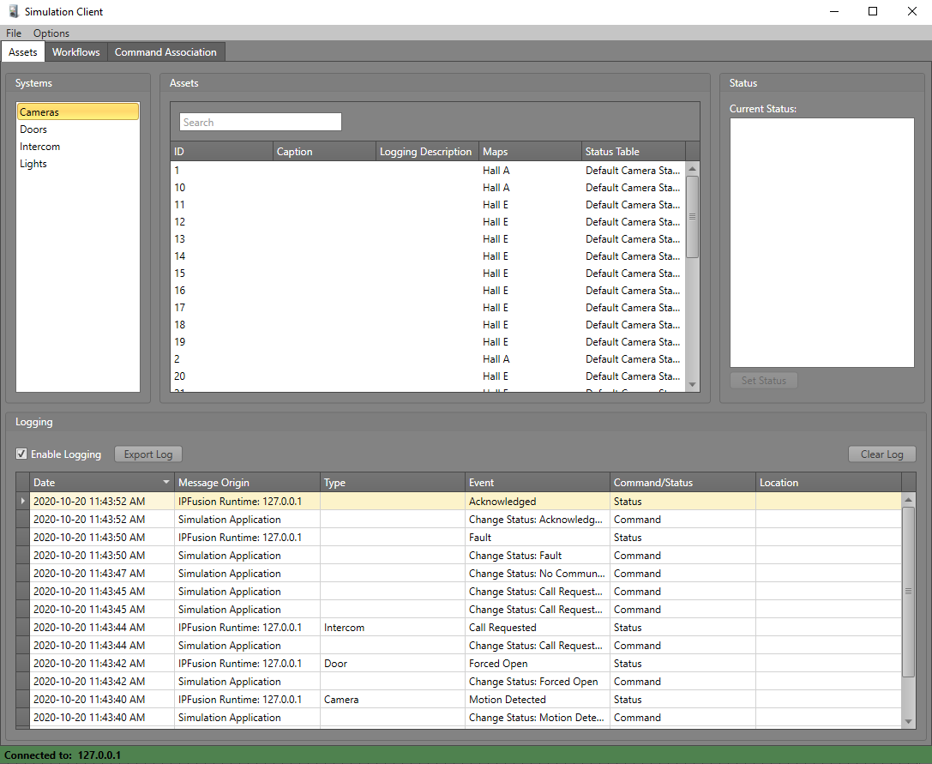
Overview
Test project configuration without connecting to real devices.
Simulate asset states, commands, Workflow executions, etc.
Enhance training and demonstration of the system.

Slide 4
Launching Runtime in Simulation Mode

Slide 5
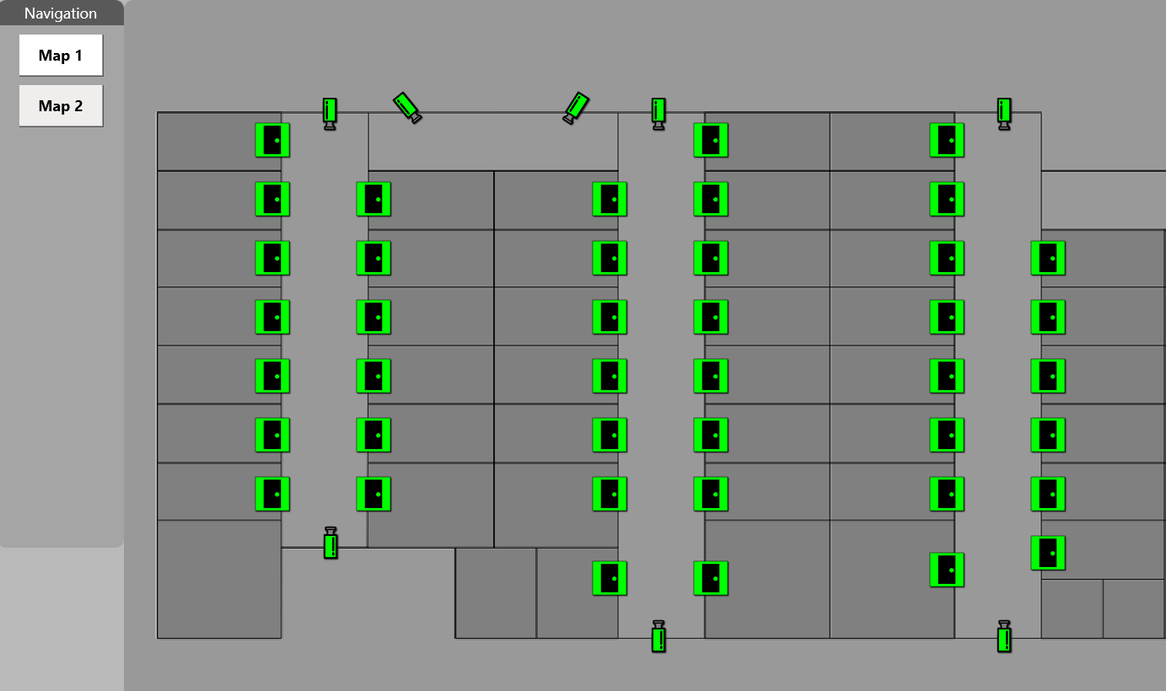

Runtime Simulation Mode
Select the Simulation option in the Home tab in the Designer.
Project will open with assets simulating their connection states.

Slide 6
Launching and Connecting the Simulation Client

Slide 7
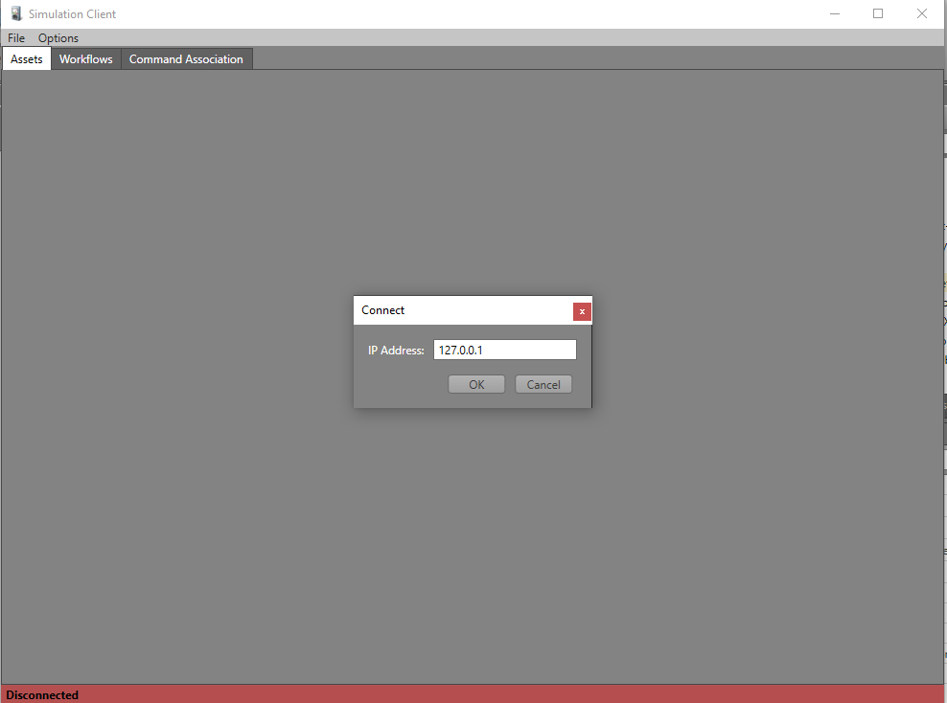
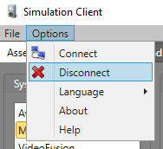
Launching the Simulation Client
Launching the application will prompt users to connect to a Runtime Simulation.
  Can connect to local computer or a remote instance via IP Address or host name.
Users can connect and disconnect anytime via Connection menu.

Slide 8
Live Logging

Slide 9
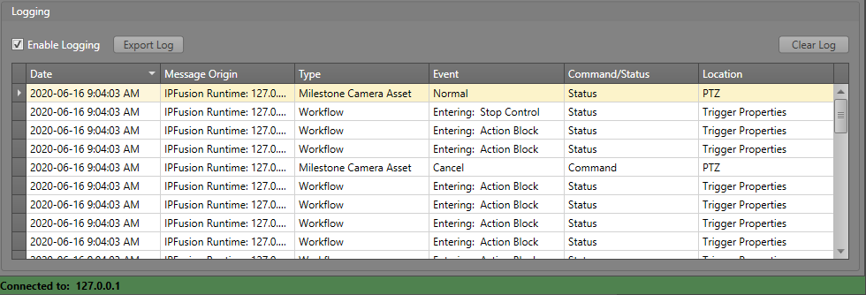
Live Logging
All actions done in the Runtime Simulation and the Simulation Client are logged and displayed live.
Users can export the logs as a file.

Slide 10
Simulating Device Statuses

Slide 11
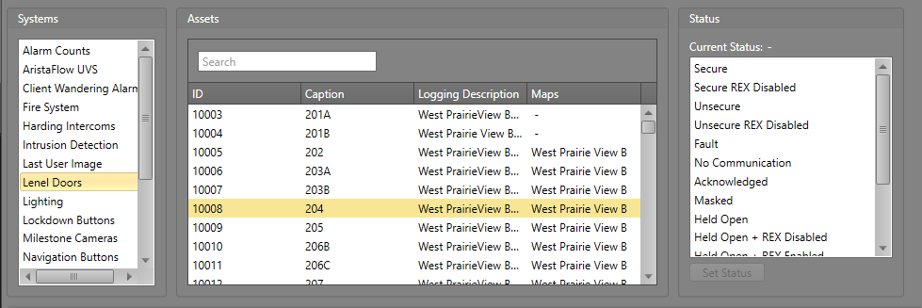
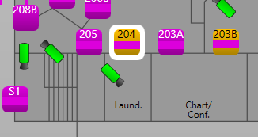
Simulating Device Statuses
All integrated systems and assets in the project will be listed.
Search for the specific asset and select the state to simulate.

Slide 12
Creating Command Associations

Slide 13
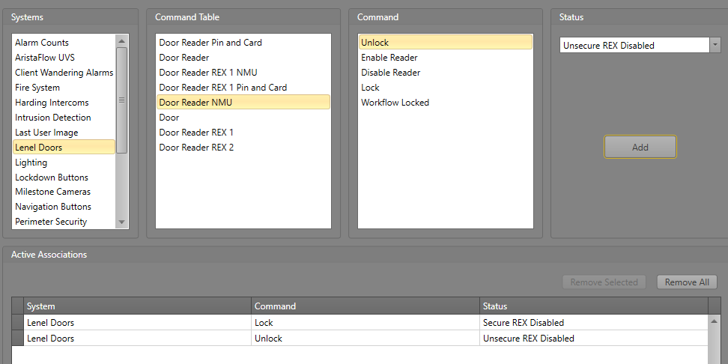
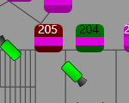
Command Associations
By default, commands besides the built-in IPFusion ones do not change the asset status.
Create Command Associations in order to simulate the integrated system specific state changes.
Left door - Unlock
Right door - Lock

Slide 14
Executing Workflows

Slide 15
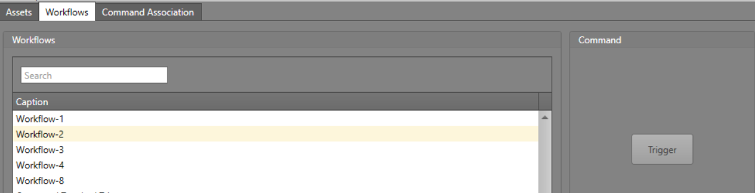
Executing Workflows
Workflows can be triggered by selecting the Workflows tab, clicking the Workflow then Trigger.
Allows you to see how a Workflow will execute in Runtime.

Slide 16
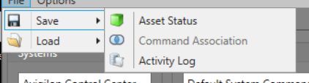
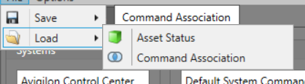
Saving/Loading Settings and Associations
Users can save the state of the simulated assets and load them for later observations and debugging.
The same goes for the Command Associations declared.
Saves them as csv files, so they can be edited outside the Simulation App.

Slide 17
Module 9 Complete

