Slide 1
Module 3
Project Development

Slide 2
Project Scenario

Slide 3
Project Scenario
Create a project using:
  Milestone Cameras
  OnGuard Doors
  Control By Web I/O
  Twilio Phones
Connect to system hardware
Configure Maps and Display Layouts
Set up Workstations

Slide 4
New Project Wizard

Slide 5
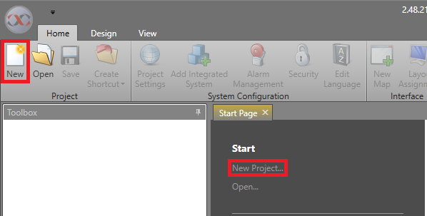
New Project Wizard – New Project
Create a new project

Slide 6
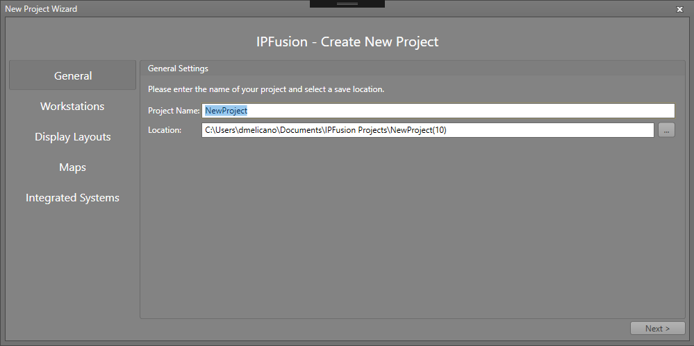
New Project Wizard – General
Enter project name
Enter project location

Slide 7
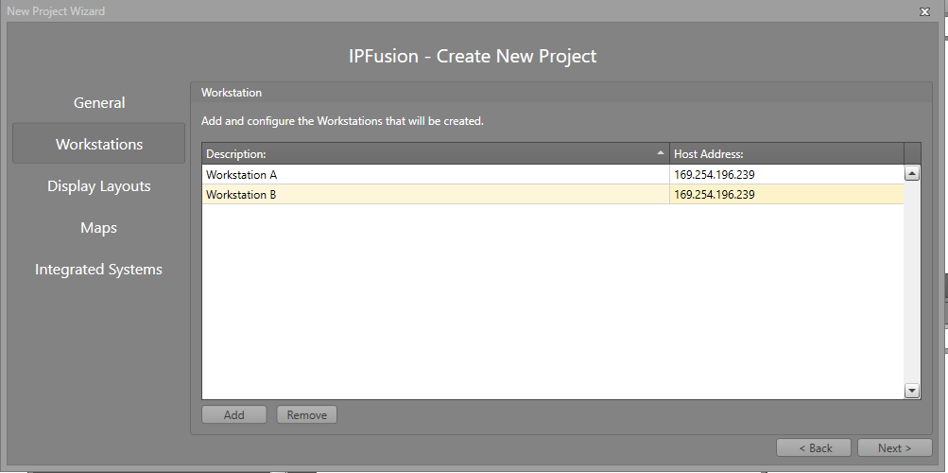
New Project Wizard – Workstations
Add Workstations to the project
Configure Workstation description and host address.

Slide 8
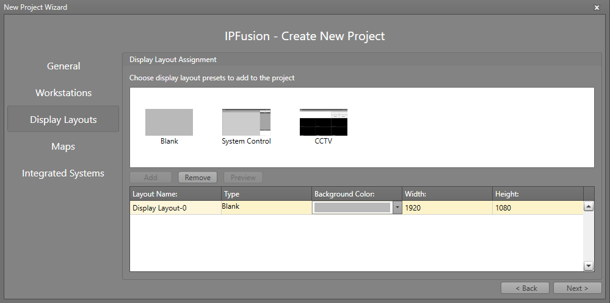
New Project Wizard – Display Layouts
Select a preset format to add. You can preview the layout as well.
Declare Display Layouts and provide them with a template

Slide 9
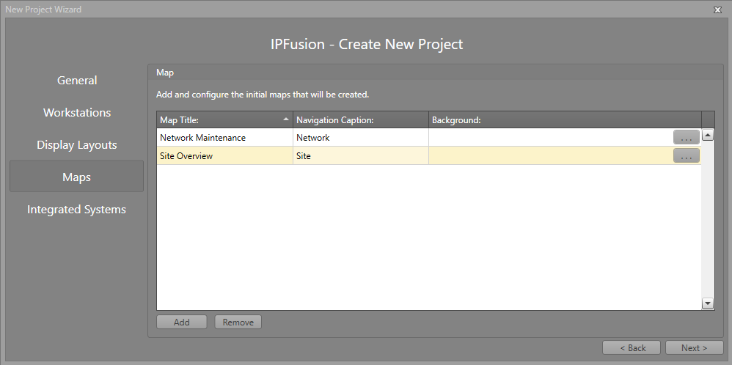
New Project Wizard – Maps
Add Maps to the project
Configure general Map settings (Map Title, Navigation Caption, Background Image)

Slide 10
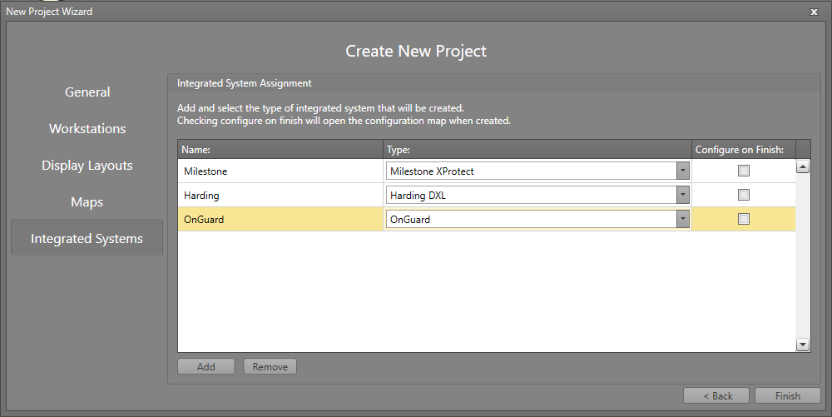
New Project Wizard – Integrated Systems
Add integrated systems to the project.
Choose whether to configure systems after project creation.

Slide 11
Configure Display Layouts

Slide 12
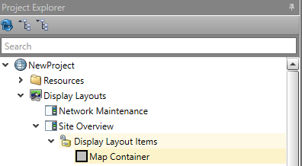
Configure Display Layouts – Basics
The different display layout presets contain various items.
  The “Blank” layout however only has a Map Container Item.

Slide 13
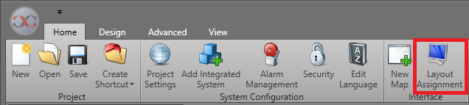
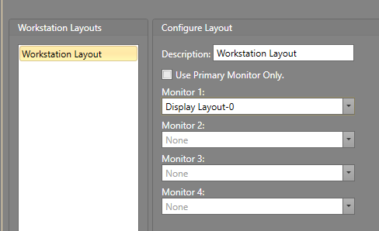
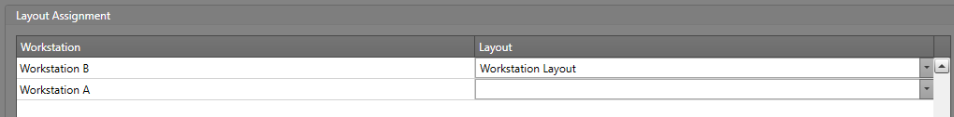
Configure Display Layouts – Layout Assignment
Open Layout Assignment
In Layout Configuration set the display layouts to be used by each monitor or just use the primary monitor
In Layout Assignment, set the layouts for each Workstation per specifications

Slide 14
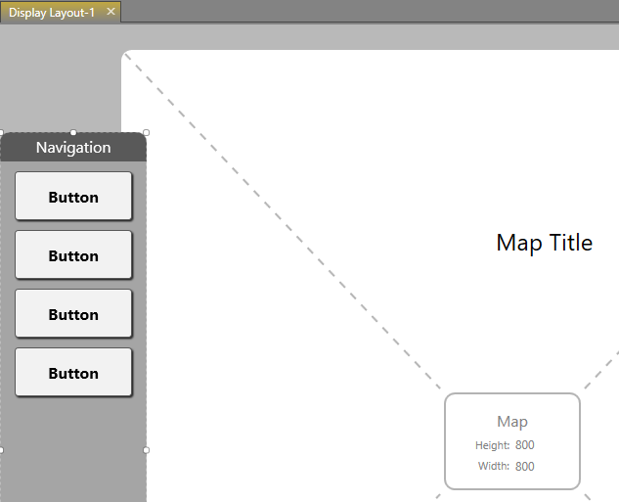
Configure Display Layouts – Navigation
Link Navigation Item to a Map Container via Properties
Navigation is set per Navigation Item
Configure Navigation Item’s navigation paths with the Properties > Button Schemes Configuration > Navigation Wizard

Slide 15
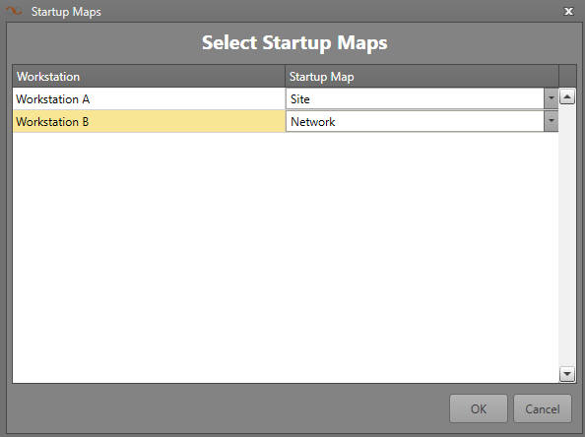
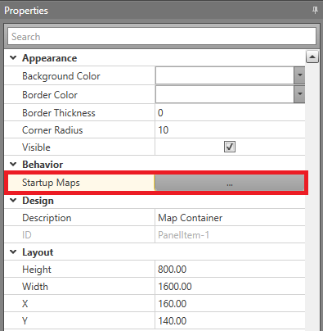
Configure Display Layouts – Startup Map
Set Startup Map per Map Container within the Map Container’s Property (Startup Maps)

Slide 16
Configure Maps

Slide 17
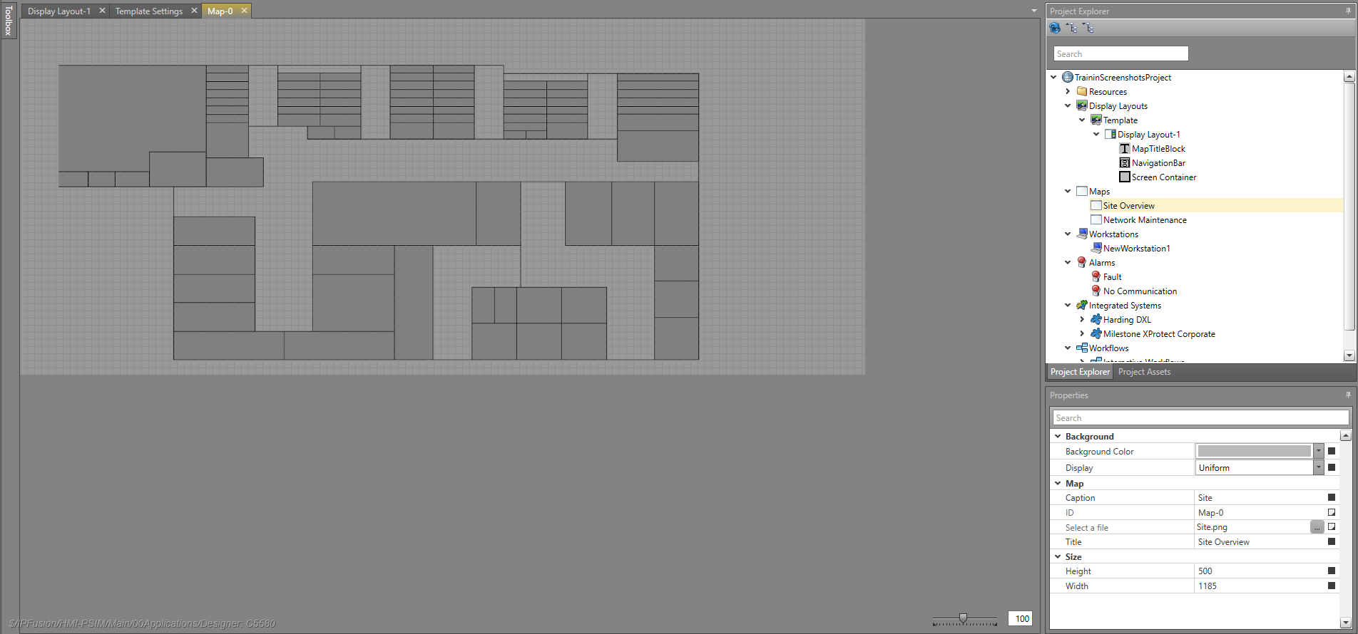
Configure Maps
Set width and height of both maps per specifications

Slide 18
Add Assets

Slide 19
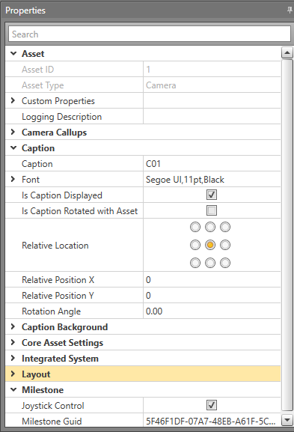
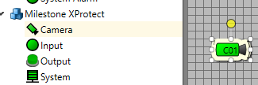
Add Assets – Milestone Camera
Drag Milestone cameras from toolbox to screen
Configure properties

Slide 20
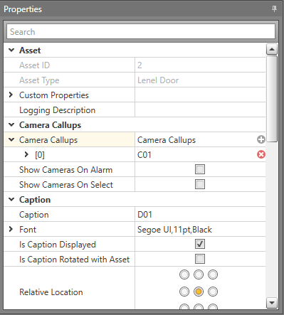
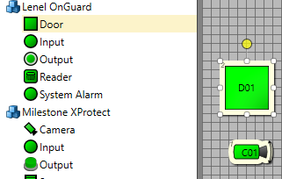
Add Assets – OnGuard Door
Drag OnGuard Door from toolbox to screen
Configure properties
Choose a camera for camera callup

Slide 21
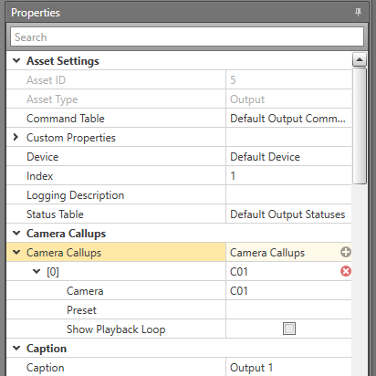
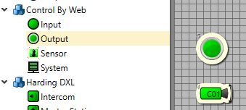
Add Assets – Control By Web I/O
Drag Inputs/Outputs from toolbox to screen
Configure properties
Choose a camera for camera callup

Slide 22
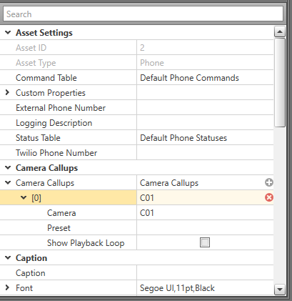
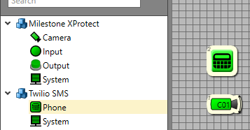
Add Assets – Twilio Phone
Drag Twilio Phone from toolbox to screen
Configure properties
Add your phone number to Destination Phone Number

Slide 23
Configure Integrated Systems

Slide 24
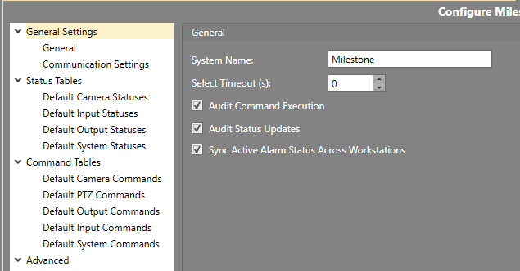
Integrated Systems — General
Configure general settings per project specifications
Set select timeout to 0 seconds for each system
Turn on audit command execution and audit status updates for each system

Slide 25
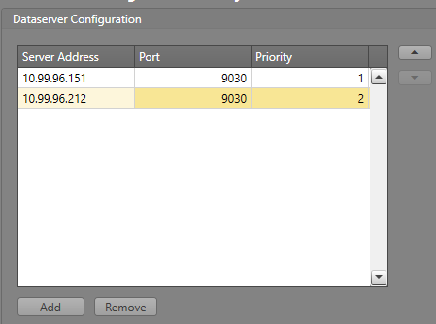
Integrated Systems – IPFusion Data Servers
Input Data Server settings as per Specifications

Slide 26
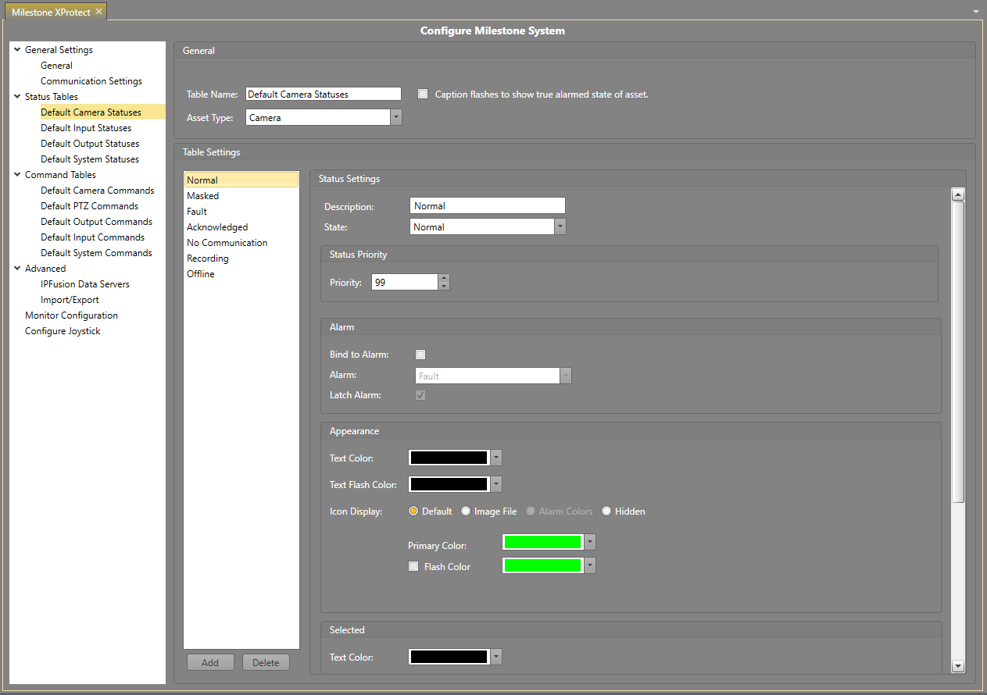
Integrated Systems – Status Tables
Leave status tables as defaults for each system

Slide 27
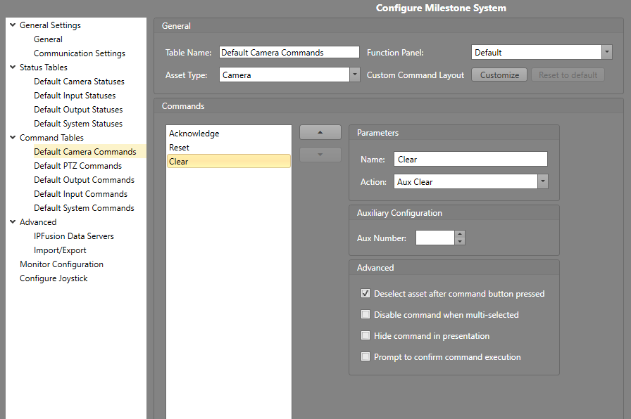
Integrated Systems – Command Tables
Configure command tables per project specifications

Slide 28
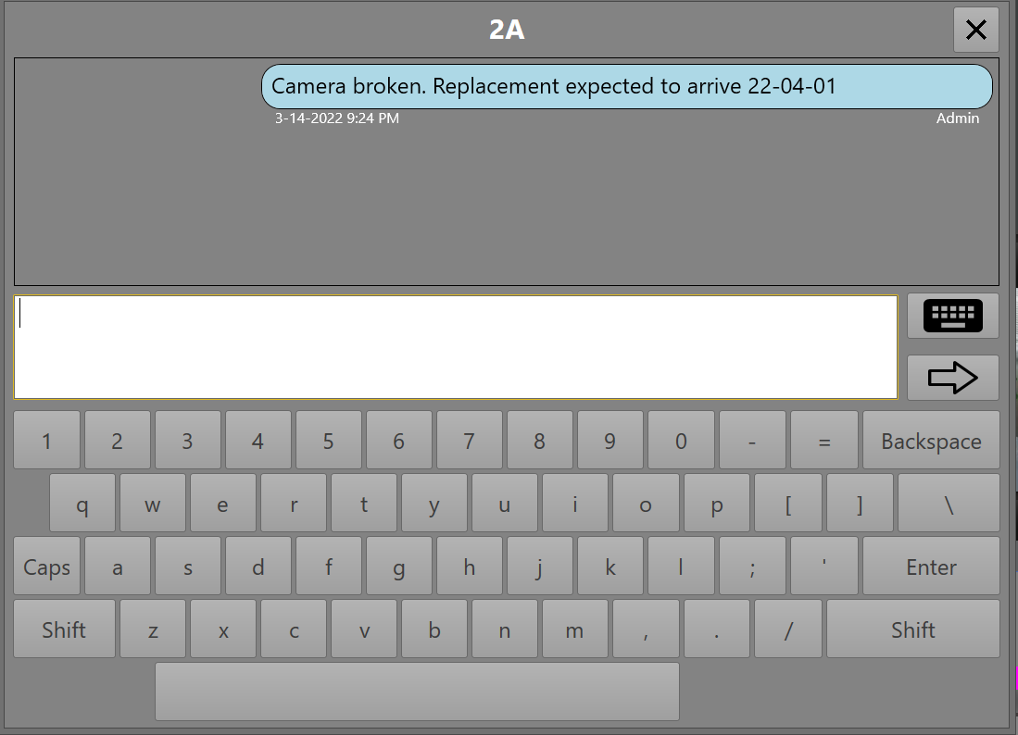
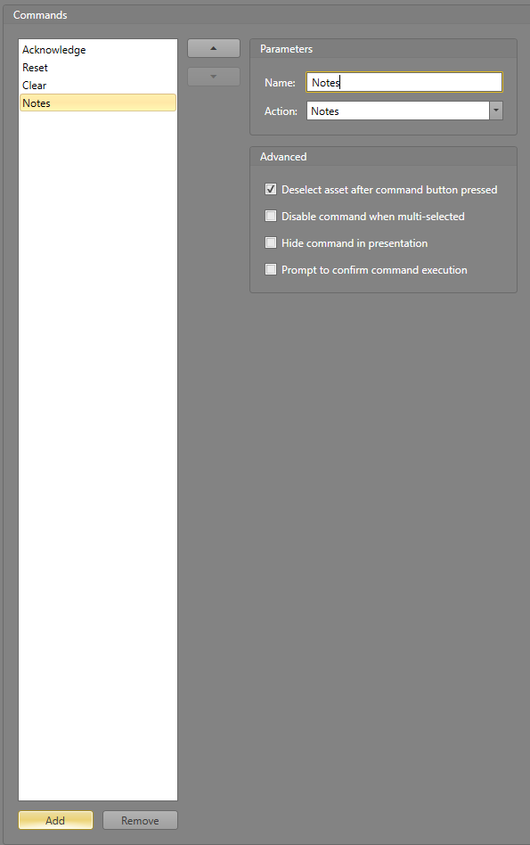
Integrated Systems — Command Tables
Add a Notes command
Notes allow the Runtime operators on different Workstations to store information on the asset in real-time

Slide 29
Assign Command & Status Tables

Slide 30

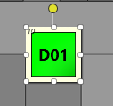
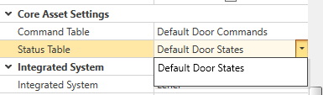
Assign Command & Status Tables
Assign the configured command and status tables for each asset

Slide 31
Configure Legend

Slide 32
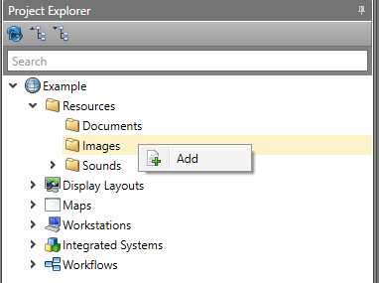
Configure Legend – Add Legend
Add Legend image to resources

Slide 33
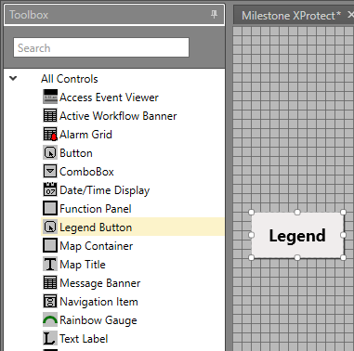
Configure Legend – Add Legend Button
Open each of the Display Layouts
Drag a Legend Button onto each layout from the toolbox

Slide 34
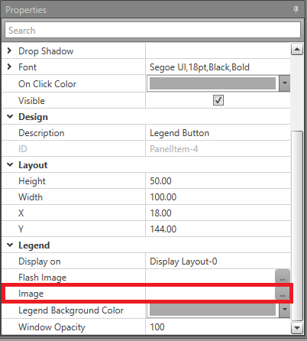
Configure Legend – Assign Legend
Click Image in the Properties grid

Slide 35
Video Viewer

Slide 36
Video Viewer
Configure cameras to use the GuIDs found in the project specifications
Launch Runtime in simulation mode
Select the camera, then touch the video viewer panel in the bottom right of the screen
The camera stream will be shown in the video viewer

Slide 37
Custom Alarm Type Example

Slide 38
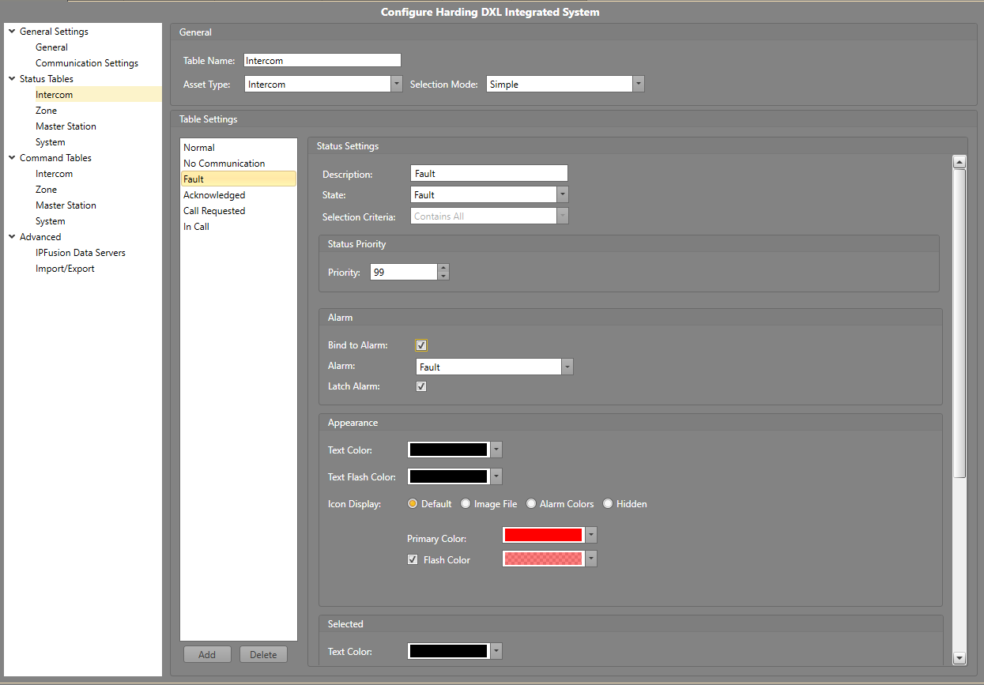
Custom Alarm Type Example
Assign alarm type Fault to the intercom Fault state
Make sure the Latch property is checked.

Slide 39
Custom Alarm Type Example
Launch Runtime in simulation mode
Launch simulation application
Set all intercoms to Normal state
  All intercoms should show a green icon
Set intercom I01 to Fault state
  This should generate an alarm that can be seen in the alarm banner
  The intercom icon should be flashing red and white
  The alarm should have the type Fault and be flashing red and white

Slide 40
Connecting to a Live System

Slide 41
Connecting to a Live System
Configure integrated system IPFusion data server and communications settings per specifications
Launch Runtime to interact with devices on the live system

Slide 42
Module 3 Complete

