Slide 1
Module 10
Advanced Features:
Security Management

Slide 2
Overview

Slide 3
Overview
Manage users and groups access to IPFusion.
Manage automatic logouts and maximum login attempts.
Can use either IPFusion or Active Directory as the security provider.

Slide 4
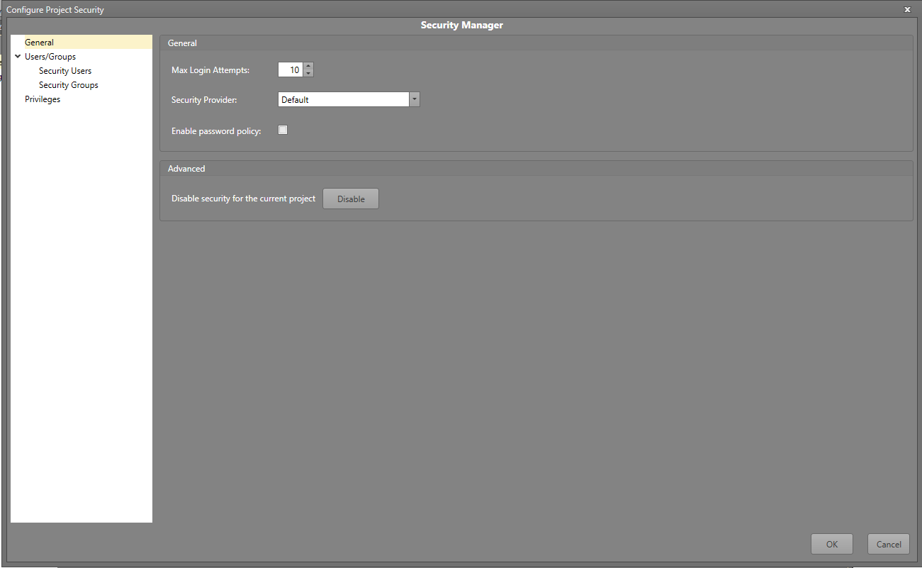
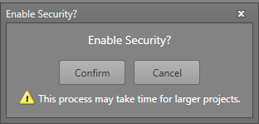
Overview – Enabling Security
Selecting the Security option in the Advanced tab will open a prompt to enable security settings.
The project will then restart after confirmation.
Afterwards, the Security Manager will open and both Designer and Runtime security are now enabled.
Users will be logged in as Admin by default after the reboot.

Slide 5
Overview – Designer Security Prompt
* This view can have additional options based on the Security Provider

Slide 6
Overview – Runtime Security Prompt
* This view can have additional options based on the Security Provider

Slide 7
Security Manager

Slide 8
Security Manager: General
Max Login Attempts — Set the number of login attempts the user can make.
Security Provider — Select whether the security settings will be the local IPFusion (Default) settings or from Active Directory.
Note: For Active Directory, your Designer and Runtime Workstations must be joined to the Active Directory Domain.
Enforce password policy — Force all newly created and updated passwords to be complex.
Disabling security will restart the project to reflect the change.

Slide 9
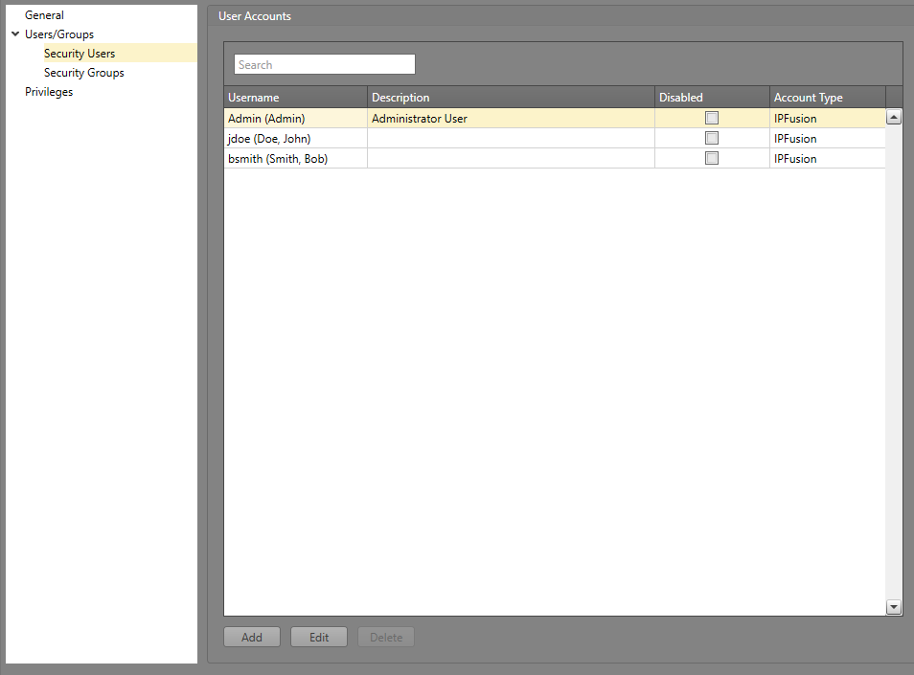
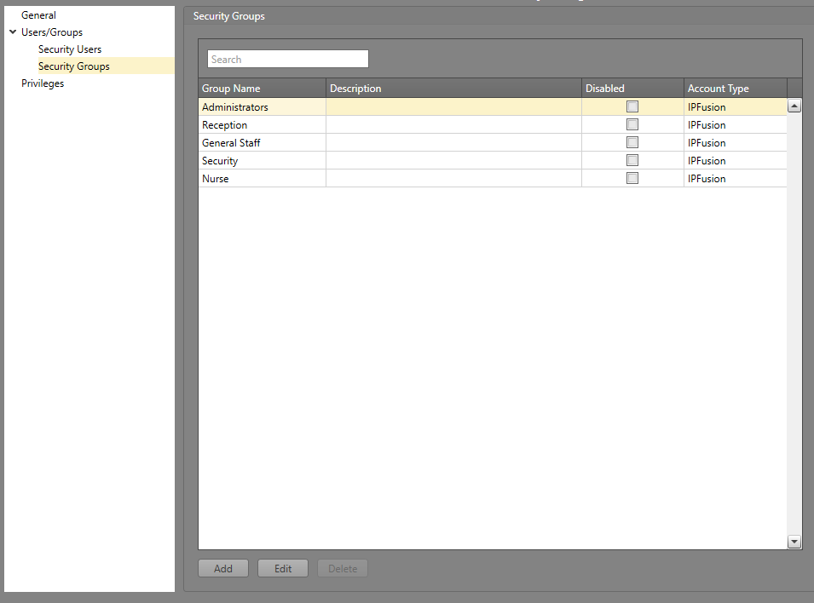
Security Manager: Users/Groups
The system administrator can set up user accounts and user groups that have varying degrees of permissions in the software.
Each user, barring the Admin, will need to be assigned a group.
A single user can be in multiple groups if needed.
When Active Directory is the security provider, groups and their associated users can be imported in the group configuration.

Slide 10
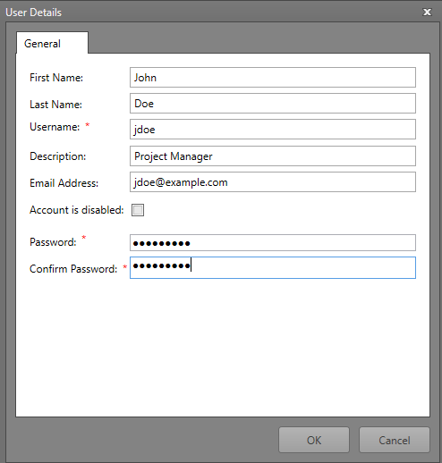
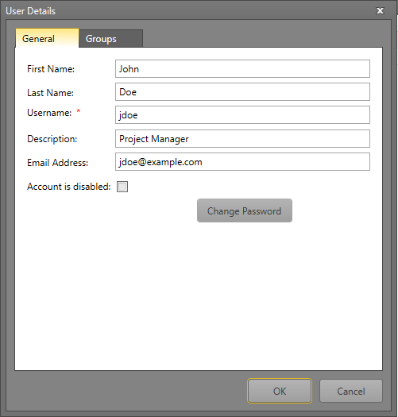
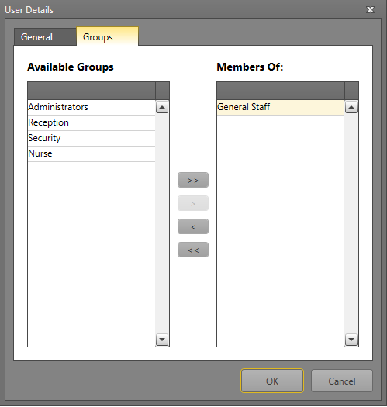
Security Manager: Defining Users
The user’s information and credentials will need to be input when creating a new account .
Editing existing user accounts also allow their assignment to groups.
Edit user account and add to a group
Add new user account

Slide 11
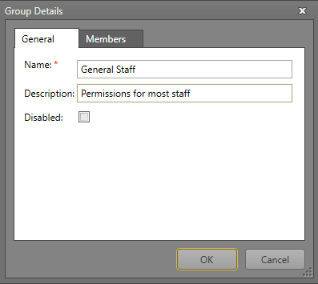
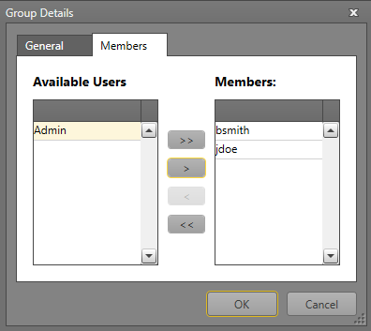
Security Manager: Defining Groups
Simply provide the name and assign members to create a new group.

Slide 12
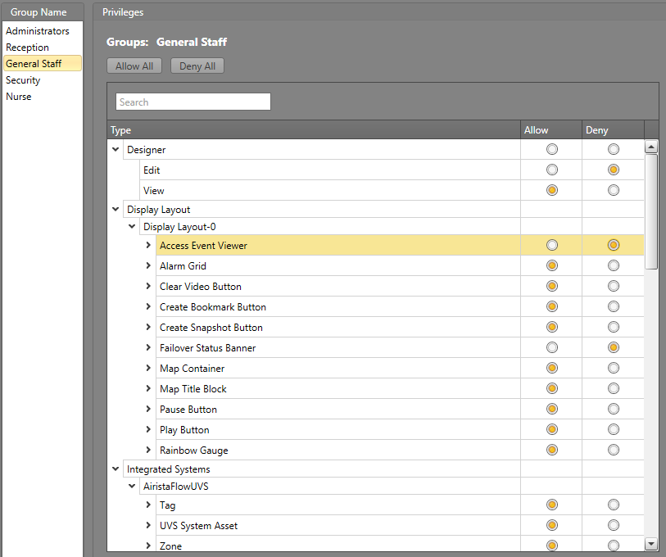
Security Manager: Assigning Privileges
User Groups can have varying privileges that control how much they can interact with the project.
Select the allowed and denied actions based on the purpose of the groups and its members.
*The Administrators group has all privileges allowed

Slide 13
Active Directory Integration

Slide 14
Active Directory Integration
Using Active Directory for the Security Provider allows you to use the already created users and groups in the domain.
If you use IPFusion instead, you will need to create the users and groups within Security Manager.

Slide 15
Module 10 Complete

