Slide 1
Module 12
Advanced Features:
Language Manager

Slide 2
Overview

Slide 3
Overview
Allows the addition and editing of the language used in displaying the text strings in Runtime.
Useful when a site needs to have multiple languages for multilingual operators and international operations.

Slide 4
The Default Language

Slide 5
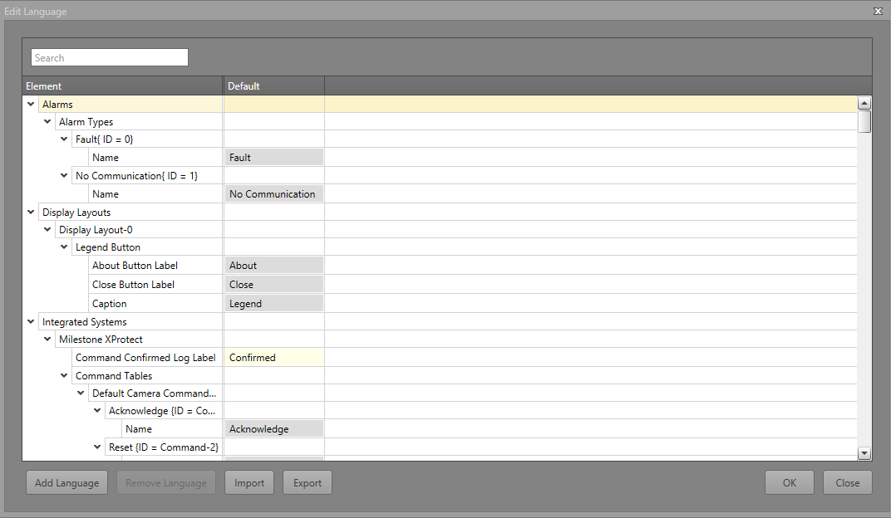
Runtime Default Language
When a project is initially created, it creates a default language file.
This file contains all the default texts and strings of the different IPFusion Runtime components
For example: windows, views, button text, integrated system status and command names, asset captions, logging descriptions, etc.
Strings which are not editable elsewhere in Designer can be edited here

Slide 6
Adding and Removing Languages

Slide 7
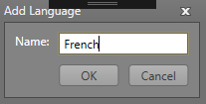
Adding Languages
Click the Add button and input the desired name of the new language. Add the text for the language in the associated column.

Slide 8
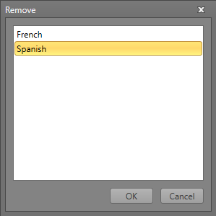
Removing Languages
Click the Remove button and select the language to be deleted.
The Default language cannot be deleted.

Slide 9
Import and Export Languages

Slide 10
Import and Export Languages
Users can Import and Export the created language strings.
They are exported as a .csv file and can easily be edited using external programs.
Users can then import the edited language .csv file and the changes will be reflected.

Slide 11
Change Language

Slide 12
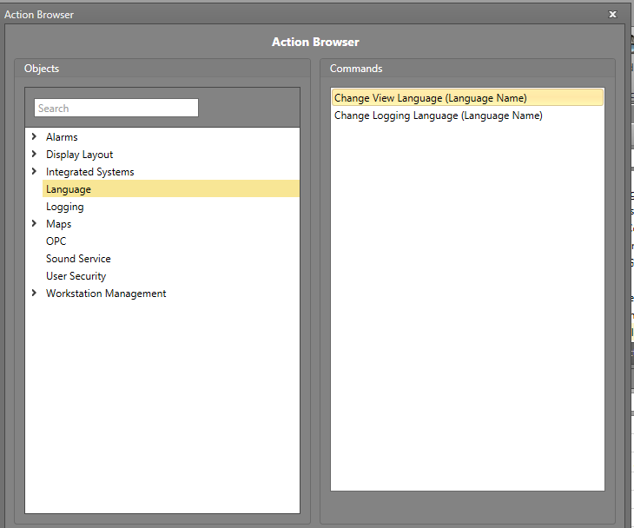
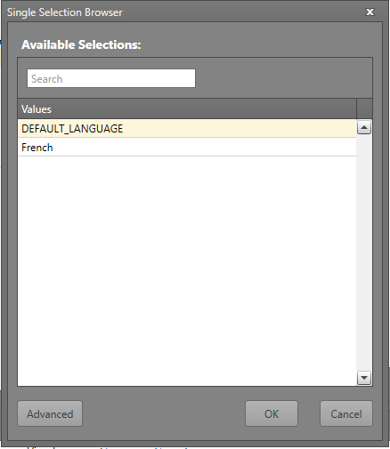
Change Language — Runtime
The Runtime language can be changed using Workflows
Using an Action block, select the Language > Change View Language command
Click Language Name and select the language to use

Slide 13
Change Language — Logging
The language used for the logs can be configured in the Project Settings
Go to Logging and select the language to use from the drop-down menu

Slide 14
Module 12 Complete

