Slide 1
Module 14
Advanced Features:
IPFusion OPC and the Tag Database

Slide 2
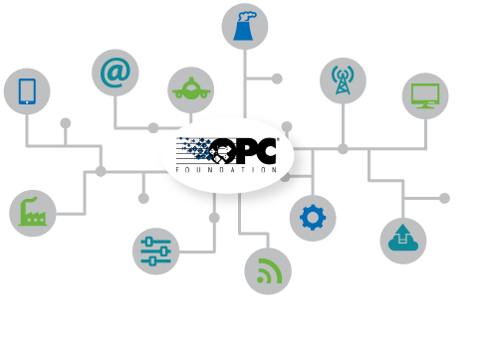
OPC
OPC (Open Platform Communications) specifies the communication of real-time data between control devices from different manufacturers.

Slide 3
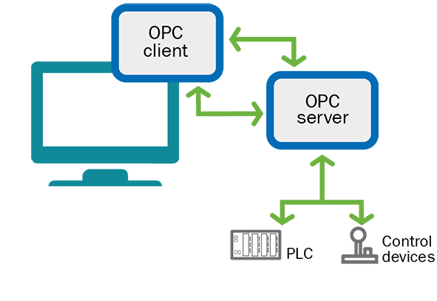
OPC DA
OPC DA (Data Access) is a group of client-server standards that provides specifications for communicating real-time data from acquisition devices such as PLCs (Programmable Logic Controllers) to display and interface with an HMI (Human Machine Interface).

Slide 4
IPFusion OPC
IPFusion OPC Tag Database creates a connection to OPC devices by using tags — the representation of the OPC variable or datapoint.
IPFusion OPC Tag Database provides the OPC Client ability for IPFusion Runtime.
IPFusion OPC Tag Database can connect to many OPC Servers. A common one is Industrial Gateway Server.
It enables the querying of states, and execution of commands locally or remotely.

Slide 5
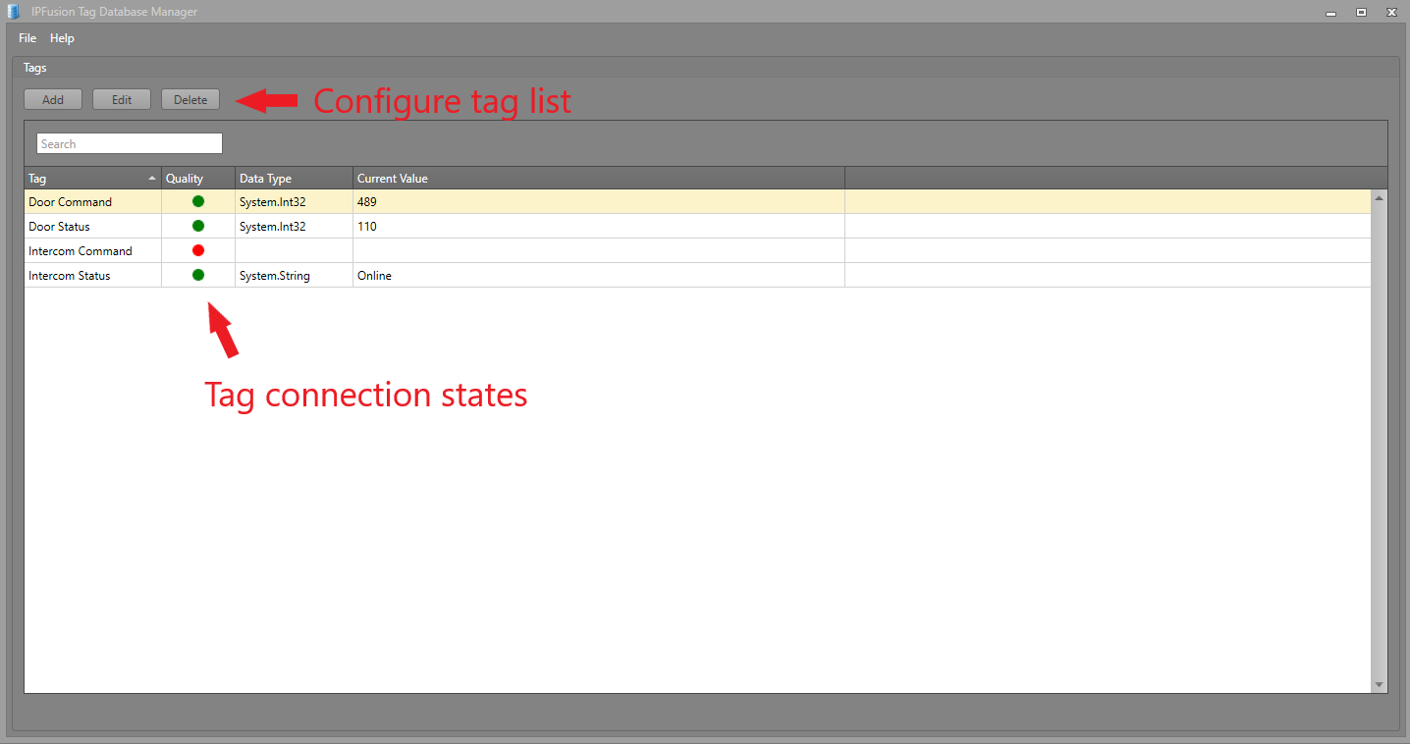
IPFusion Tag Database Manager

Slide 6
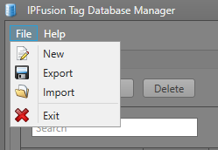
OPC Tag Database Menu
New — Create a new tag configuration
Export — Export the current tag configuration to a file
Import — Import tag configuration from a file

Slide 7
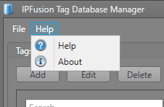
OPC Tag Database
Help — Access to User Manual
About — View information about the application version

Slide 8
Create a tag definition file
Tag Definition XML file contains the collection of Tags added and configured in the Tag Database Manager.
Users can only add tags when the Tag Database Service is running.
When the Add/Edit tag window is brought up, you are presented with two main fields to fill
  Name — The name of the OPC Tag that will be added. Runtime interfaces with this name.
  Type — The tag type of the OPC Tag. There are two different tag types, and each have their own advanced settings to be filled: OPCDA Source and Virtual.

Slide 9
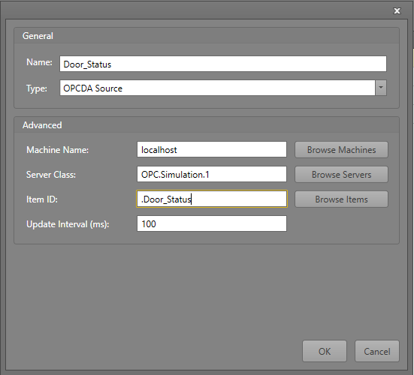
OPCDA Source Tag Type
Used to connect to an Open Platform Communications Data Access Server tag. It uses OPC technology to find the OPC servers that are running on the local computer.

Slide 10
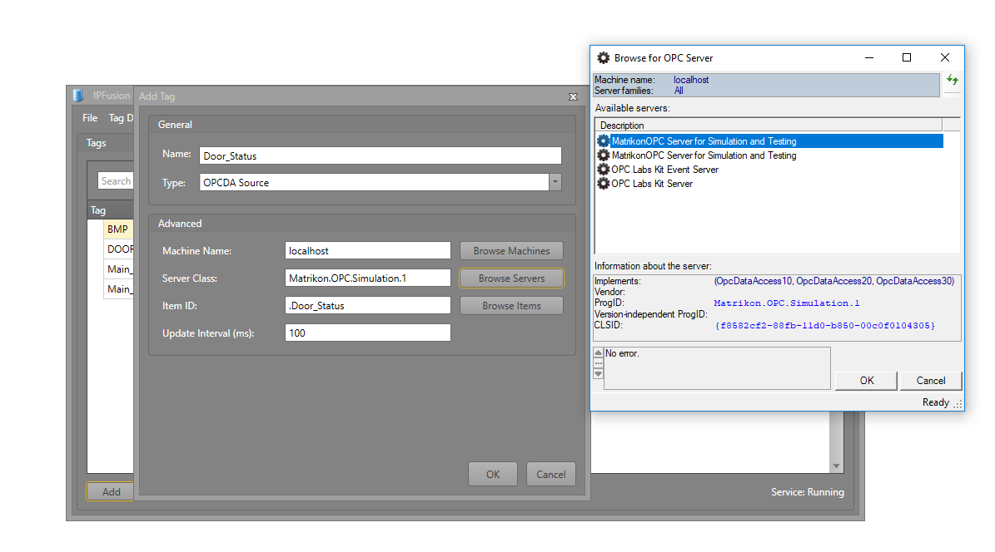
OPCDA Source Tag Type
Select the OPC Server

Slide 11
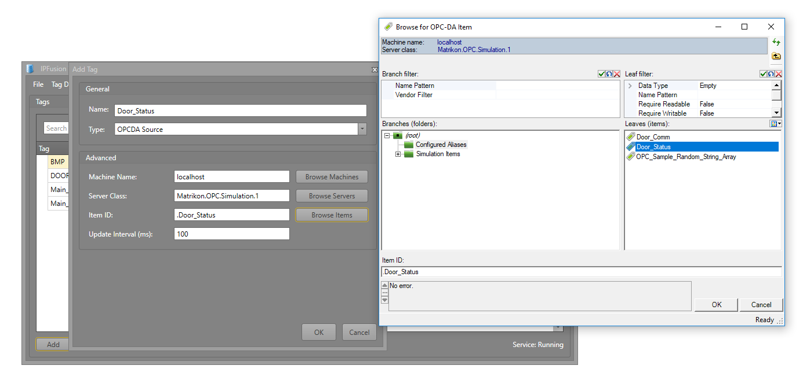
OPCDA Source Tag Type
Select the OPC Item

Slide 12
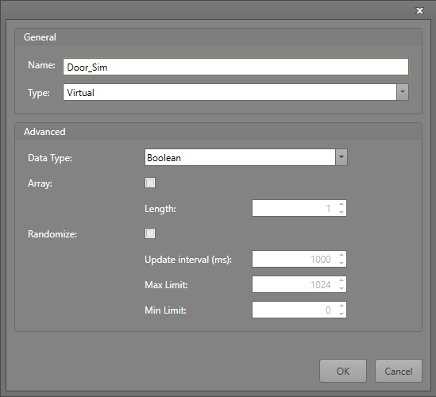
Virtual Tag Type
Used for creating simulated values that are not tied to any Tag Database/Server — primarily used for testing.

Slide 13
Virtual Tag Type
Data Type — The type of data that the tag will be. It can be either an Int, Boolean, or String.
Array — Check this box if the tag will contain multiple values. Uncheck for only a single value.
Length — If the Array option is checked, this field indicates how large the array of values will be.
Randomize — Check this box if you want the tag to continually update with random values. Live Tag Updates must be on to see this change.
Update Interval — When Randomize is checked, this field is the time interval, in milliseconds, between each update of the value in the tag.
Max Limit — The max value limit that the tag values can have when Randomize is checked and the integer type is selected. This is not used for Boolean types. For String types it is the length of the random string.
Min Limit — The minimum value limit that the tag values can have when Randomize is checked and the Integer type is selected. It is not used for String and Boolean types.

Slide 14
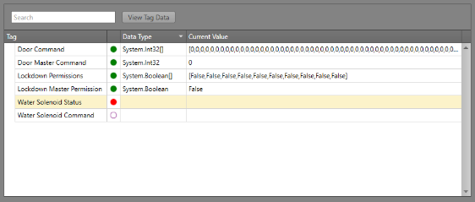
Live Tag Display – Writing and Editing Data
In the Live Tag Display, OPC Tags that have been added will display their current values and statuses.
  Tag — The name of a specific OPC Tag. The column to the right is the tag’s data quality state.
  Data Type — The type of the OPC Tag.
  Current Value — The values associated with the OPC Tag. These change depending on the values in the tag’s source.

Slide 15
The Data Editor View
Shows the values used by IPFusion to display the proper OPC asset statuses or to receive commands from the PLC and to write a new value to the database to signal to the PLC that a status change or command has been issued.
Each value is located in a textbox. Depending on the settings of the tag data from the OPC Server/Tag Database and the PLC, users can manually write values into these to enforce sending a command or a status change.
Type the value into the corresponding position. Click Write. The value must be the correct data type, and should be the meaningful value pertaining to an event in the PLC.

Slide 16
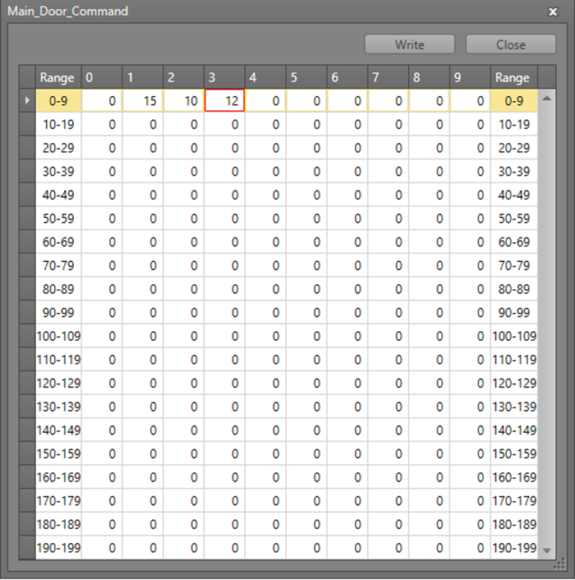
The Data Editor View

Slide 17
Toggling Live Updates
Toggling the Live Tag Update option on or off will allow the Tags to automatically display their most recent values.
The OPC Tag Database Manager service continues communicating between Runtime and the OPC Servers regardless of this checkmark.

Slide 18
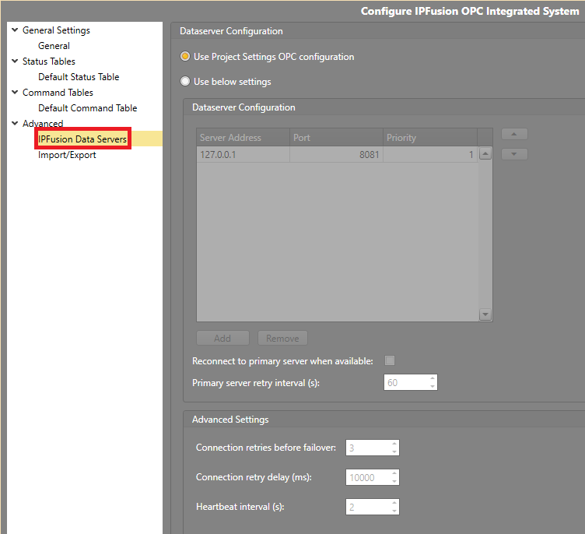
Connect IPFusion to Tag Database Manager
The following steps will show how Designer can tie an OPC Tag IO Integrated System Asset to a specific tag:
In IPFusion, open the configuration view of the required OPC based Integrated System. Go to Advanced > IPFusion Data Servers. Select Use Project Settings OPC Configuration or Use Below settings.

Slide 19
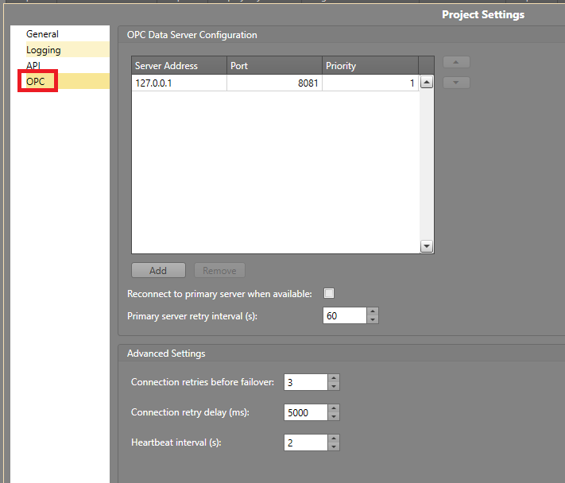
Connect IPFusion to Tag Database Manager
The Project Settings > OPC Dataserver has the same configuration layout as the integrated system’s Dataserver view. Type in the IP Address of the machine containing the Tag Database Manager in for IPFusion to connect to it. Optionally, use different settings located in these views as needed.

Slide 20
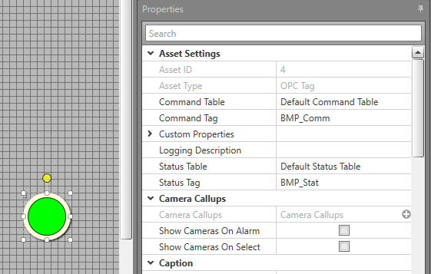
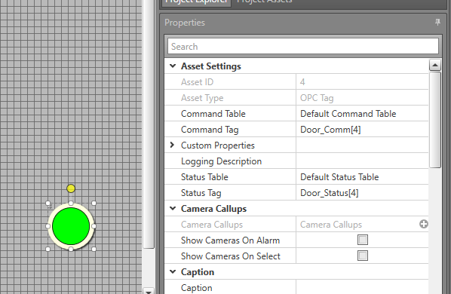
Connecting OPC Tag Database Manager
Go to the corresponding asset that needs the tag. In the asset’s Properties > Asset Settings in the Command Tag and Status Tag properties, type in the name of the corresponding tags, and if it is an array tag, follow the name with the proper index.

Slide 21
Use Cases
Correctional Facilities
  Delco PLC Doors (PLC based Door Control)
  OPC Tag IO (PLC based Door Control, Lights, Buttons, Television, Water, etc.)
  Graphical Objects

Slide 22
Module 14 Complete

